Slide 1
ENGAGED READERS AND EFFECTIVE ADVERTISING
Notes:
Advertising is about more than awareness or exposure. Effective advertising is about engagement. The most effective advertising campaigns engage consumers on multiple platforms and touchpoints.
News Media Canada, with the support of the Government of Canada’s Department of Canadian Heritage, contracted Totum Research to conduct research to explore the complex issue of engagement with media and advertising.

Slide 2
BUILDING TRUST AND ENGAGEMENT
How do Canadians engage with news and advertising in traditional and digital media given the current climate of fake news and distrust?
News media build trust and engagement by creating and delivering quality content to provide an effective environment for advertising.
Notes:
How do Canadians engage with news and advertising in traditional and digital media given the current climate of fake news and distrust? News media and creators, large and small, face the challenge of building trust and engagement in order to create and deliver quality journalism and content as well as an effective environment for advertising.

Slide 3
CUT THROUGH THE MEDIA CLUTTER
The sheer volume of media and advertising messages in multiple formats is overwhelming.
Consumers are exposed to thousands of brands/ads daily - less than 100 will create awareness and only about 12 will make an impression and engage consumers.
Notes:
In today’s media environment there are many choices; the sheer volume of media and advertising messages in multiple formats is overwhelming. Every day consumers are exposed to thousands of brands and ads but less than 100 will create awareness and only about 12 will make an impression and engage consumers.
Studies find that the average person is exposed to hundreds of ads and up to 10,000 brand messages each day. And as marketers are presented with more and more channels to reach their customers that number is growing rapidly. Out of those thousands of ads and brand messages it is estimated that only 12 ads will make an impression. Key considerations to make sure an ad is noticed include Trust, Engagement and Frequency. Multi media campaigns result in stronger consumer engagement in a world where advertisers must compete for the attention of consumers.
https://sjinsights.net/2014/09/29/new-research-sheds-light-on-daily-ad-exposures/
http://www.mediadynamicsinc.com/uploads/files/PR092214-Note-only-150-Ads-2mk.pdf
Average number of advertisement and brand exposures per day per person: 5,000+
Average number of “ads only” exposures per day: 362
Average number of “ads only” noted per day: 153
Average number of “ads only” that we have some awareness of per day: 86
Average number of “ads only” that made an impression (engagement): 12
https://www.vpngeeks.com/internet-statistics/

Slide 4
HOW TO GET NOTICED
How can advertisers motivate consumers to research their products, take action and ultimately buy their products and services?
ENGAGEMENT
Increasing engagement helps advertising break through the clutter of not only the hundreds of ad exposures per day, but of the thousands of ad and brand exposures per day.
Notes:
Advertising doesn’t just offer the right product to the right consumer at the right time.
Ads are designed to motivate consumers to investigate and ultimately buy the advertised product or service.
That’s why engagement has become so important.
Bottom-line, increasing engagement will help advertising break through the clutter of thousands of ad and brand exposures per day.

Slide 5
WHAT WE ALREADY KNOW LOCAL NEWS MEDIA ENGAGE READERS
NINE OUT OF TEN
Canadians (88%) read news media brands each week.
Community newspapers are the number one source for LOCAL information.
Readers read and rely on newspaper advertising.
News media provide a trusted environment for ads.
News media readers take action after seeing advertising.
Totum Research, Canadians 18+; June 2019
Notes:
Here is what we know engagement looks like from previous research conducted over the past few years:
Canadians are reading news media brands – 88% over the course of a week on print and digital platforms.
The number one reason for reading community newspapers continues to be LOCAL information – this is what engages readers.
Not only are readers engaged by local information, they are also reading for advertising, including flyers and inserts.
News media (in print and digital formats) continue to provide the most trusted of all ad formats. Social media and mobile ads are among the least trusted.
News media readers are inspired to take action after seeing ads – whether it is visiting stores, making a purchase or just increasing awareness.
CHARTS IN APPENDIX:
Newspapers 24/7 = 88% of Canadians read daily and community news media brands weekly.
Trusted and True = Community newspapers are the number one source for LOCAL information.
Trusted and True = Readers read and rely on advertising in their local newspapers.
Engaged and Connected = News media brands provide a trusted environment for ads.
Engaged and Connected = News media readers take action after seeing advertising.

Slide 6
DEFINITIONS OF ENGAGEMENT
GENERAL ENGAGEMENT
NEWS ENGAGEMENT
AD ENGAGEMENT
It is trustworthy.
I feel a personal connection with the medium.
It inspires me.
It makes my life better.
It enhances my interaction with others.
It operates in an ethical manner and has the public’s best interest in mind.
I go to the medium when I have time to myself.
The news it contains comes from reliable sources.
It employs well-trained and knowledgeable journalists.
It provides the news impartially.
Its news content is believable.
It contains informed commentary.
I usually notice ads in this medium.
The ads it contains make me more likely to purchase.
It is the best place to get useful information about sales, store hours and special offers.
It contains annoying ads (Note: Less annoying earner higher engagement scores)
Notes:
This new study examined engagement in more detail with 16 different statement in 3 different categories of engagement.
OVERALL MEDIA ENGAGEMENT:
It is trustworthy.
I feel a personal connection with the medium.
It inspires me.
It makes my life better.
It enhances my interaction with others.
It operates in an ethical manner and has the public’s best interest in mind.
I go to the medium when I have time to myself.
NEWS ENGAGEMENT:
The news it contains comes from reliable sources.
It employs well-trained and knowledgeable journalists.
It provides the news impartially.
Its news content is believable.
It contains informed commentary.
ADVERTISING ENGAGEMENT:
I usually notice ads in this medium.
The ads it contains make me more likely to purchase.
It is the best place to get useful information about sales, store hours and special offers.
It contains annoying ads (Note: Less annoying earner higher engagement scores)

Slide 7
Notes:
Respondents were asked about 16 different engagement statements relating to media overall, news and advertising specifically.
The ten different media measured included the traditional and digital platforms for Newspapers, Television, Radio and Magazines, as well as Social Media and Search.
Newspapers (printed/digital)
Television (traditional/digital)
Radio (traditional/digital)
Magazines (printed/digital)
Social Media
Online Search

Slide 8
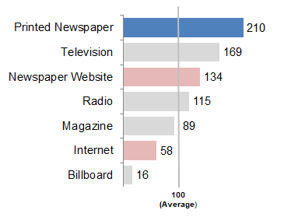
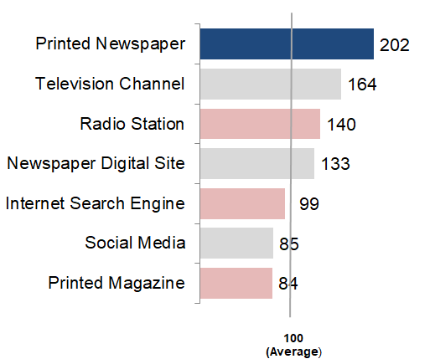
MEDIA ENGAGEMENT
2014
2019
Five years later not much has changed …
Printed Newspapers still top the list for Media Engagement.
Notes:
Five years ago, in 2014, this same study was conducted, using the same engagement statements. As you can see from the two charts, not much has changed.
Printed newspapers remained top of the list for General Engagement (indexing at 202), followed by Television. Digital newspapers index almost exactly the same (134 vs 133).
In 2014 Internet was measured as a general term – in 2019 we specifically asked about Search Engines and Social Media separately.

Slide 9
NEW RESEARCH TELLS US NEWS MEDIA ARE ENGAGING
Printed newspapers are the most engaging media.
Reading a newspaper requires full attention. Consumer attention can be fractured with other media.
Ad engagement for print newspapers is almost 2 times higher than average.*
Canadians want to see the advertising in print newspapers; it is expected to be there and is part of the content.
Ad blocking software makes it difficult for digital media to engage consumers with advertising despite high levels of general/news engagement.
Totum Research, Adults 18+; June 2019. * Index = 270
Notes:
This new research, conducted by Totum Research at the beginning of 2019 confirms that news media are engaging consumers.
The results tells us that printed newspapers are the most engaging media – out-performing other media on all 16 metrics. Intuitively this makes sense: reading a newspaper requires full attention. Consumer attention can be fractured with other media.
Ad engagement for print newspapers is almost 2 times higher than average (index 270). Canadians want to see the advertising in print newspapers; it is expected to be there and is part of the content.
Ad blocking software makes it difficult for digital media to engage consumers with advertising despite high levels of general/news engagement.

Slide 10
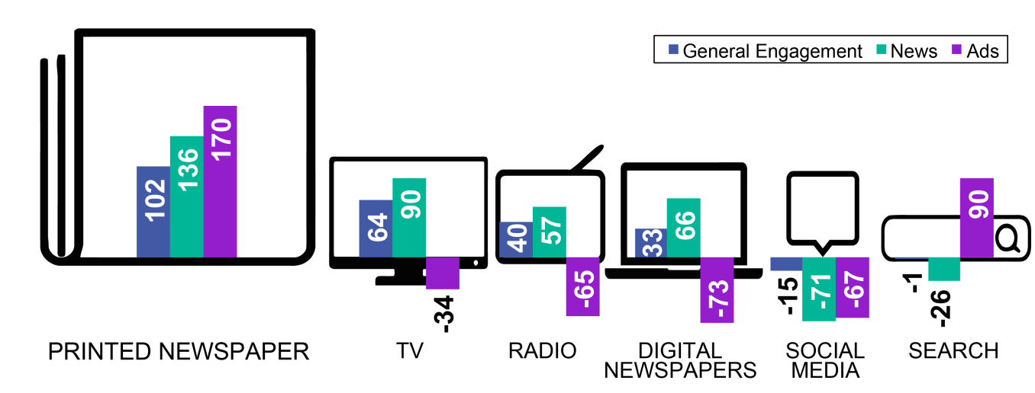
NEWSPAPERS ARE ENGAGING
Canadian adults are engaged with Printed Newspapers on all engagement measures and are almost twice as likely to be engaged by newspaper ads. The only other positive engagement with advertising is with Search ads.
Adults 18+
Top 3 Traditional Media
Top 3 Digital Media
49% of all Google searches are “no click”
INDEX 100 =
Average
Totum Research, Adults 18+; June 2019.
Notes:
Canadian adults are engaged with news media brands based on 16 statements on media engagement, news engagement and ad engagement. The results confirm that Canadians are almost twice as likely (index 170) to be engaged by printed newspaper ads. The only other positive engagement with advertising is with Search ads.
This chart shows the top 3 traditional and top 3 digital media for the 3 engagement categories (general media, news, ads) but the results are based on indexing all media for comparison purposes (An index of 100 = Average).
On General Engagement measures (trustworthy, ethical, inspires me, etc) most media score positively (printed newspapers, TV, radio, digital newspapers), except for social media and search. When it comes to engagement with News Engagement we see a similar pattern. However, when it comes to engagement with Advertising it is clear that printed newspapers outrank all other media with an index 170% above average. Ad engagement is based on noticing ads, likelihood of purchasing, sourcing useful information as well as the level of annoyance.
The outlier here is the positive Ad Engagement for Search – this is primarily influenced by the specific statement “It is the best place to get useful information about sales, store hours and special offers” which indexes well above average (Search index 37/ 14 average all media = statement index 270)
This makes sense when you think about how consumers want immediate answers to these kinds of questions. However, recent research finds that 49% of all Google Searches are “no click” – users are getting all the information they need without clicking any further.
https://searchengineland.com/49-of-all-google-searches-are-no-click-study-finds-318426
(based on Index of all media measured averaged)
General Engagement = 7 statements (slide 7 notes + Appendix)
News Engagement = 5 statements (slide 7 notes + Appendix)
Ad Engagement = 4 statements (slide 7 notes + Appendix)

Slide 11
ADVERTISING EFFECTIVENESS: WHERE ARE ADS MOST EFFECTIVE?
Advertisers want their ads to be noticed.
Consumers actively avoid ads because they find them annoying and ads interrupt content.
CONSUMERS NOTICE ADS
“I usually notice ads in this medium”
ADVERTISING ANNOYANCE
“it contains annoying ads”
ADVERTISING EFFECTIVENESS SCORE
Notes:
Advertisers want their ads to be noticed.
Consumers actively avoid ads because they find them annoying and ads interrupt content.
All measured media were ranked on an Advertising Effectiveness Score - the extent to which consumers notice ads in a given media MINUS the level of annoyance that they feel when seeing ads in the medium.

Slide 12
ADVERTISING EFFECTIVENESS: WHERE ARE ADS MOST EFFECTIVE?
NOTICE ADS
ANNOYED BY ADS
AD EFFECTIVENESS
Adults 18+
Printed newspaper ads have the highest effectiveness score of ALL media.
Readers notice ads and are less annoyed by them.
Totum Research, June 2019. Based on Index (100 = Average). Ten media measured.
Notes:
With an Advertising Effectiveness Score of 77, print newspapers dramatically outranked all other media tested. Based on the data shown, TV had an Advertising Effectiveness Score of -7 and social media had a score of -16.
ADULTS 18+ Notice Ads - Annoyed by Ads = AD EFFECTIVENESS
Printed Newspapers 141 - 64 = 77 AD EFFECTIVENESS
TV 158 - 165 = -7 AD EFFECTIVENESS
Radio 103 - 116 = -13 AD EFFECTIVENESS
Digital Newspapers 81 - 96 = -15 AD EFFECTIVENESS
Social Media 58 - 74 = -16 AD EFFECTIVENESS
Search 100 - 128 = -28 AD EFFECTIVENESS

Slide 13
CANADIANS READ NEWS MEDIA BRANDS
News media, no matter the frequency of publication, or the platform, reach 88% of Canadians weekly.
Today, news media readers are able to consume content on digital platforms (computer, phone, tablet) as well as in the printed format.
Local news media engage readers by providing information that meets the needs of the people who live in their communities.

Slide 14
NEWS MEDIA ADS ARE EFFECTIVE
News media ads reach consumers in a trusted environment.
Newspaper readers are engaged and receptive to content (including ads).
Consumers notice the ads in newspapers.
Printed newspaper ads are the least annoying resulting in a higher effectiveness score.
News media consistently out-perform other media on engagement measures.
Notes:
Ad effectiveness increases in trusted environments, making news media brands an impactful way to drive action among consumers.

Slide 15
APPENDIX

Slide 16
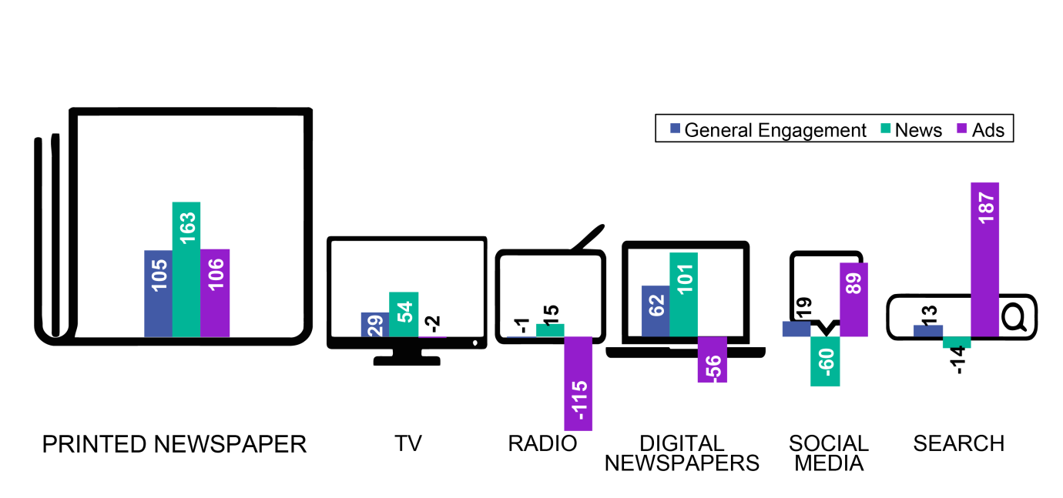
NEWSPAPERS ENGAGE MILLENNIALS
Millennials are most engaged with Printed Newspapers on General and News engagement measures. For Advertising, Millennials are most engaged with Search, Printed Newspapers and Social Media and least engaged with radio.
Millennials
Top 3 Traditional Media
Top 3 Digital Media
49% of all Google searches are “no click”
INDEX 100 =
Average
Totum Research, Millennials; June 2019
Notes:
(based on Index of all media measured averaged)
General Engagement = 7 statements (Appendix)
News Engagement = 5 statements (Appendix)
Ad Engagement = 4 statements (Appendix)
Strong Ad Engagement index for Search is primarily influenced due to the response to statement
“It is the best place to get useful information about sales, store hours and special offers” = 37/14 average all media (Index 270)
However, recent research finds that 49% of all Google Searches are “no click”
https://searchengineland.com/49-of-all-google-searches-are-no-click-study-finds-318426

Slide 17
NEWSPAPERS ARE EFFECTIVE FOR MILLENNIALS
NOTICE ADS
ANNOYED BY ADS
AD EFFECTIVENESS
Millennials
Even for Millennials, printed newspaper ads have the highest effectiveness score of all media.
Ad blockers provide an easy way to avoid digital ads which reduces effectiveness of social media and search.
Totum Research, June 2019. Based on Index (100 = Average). Millennials. Ten media measured.
Notes:
MILLENNIALS Notice Ads - Annoyed by Ads = AD EFFECTIVENESS
Printed Newspapers 115-61=54 AD EFFECTIVENESS
TV 149-135=13 AD EFFECTIVENESS
Radio 104-122=-18 AD EFFECTIVENESS
Digital Newspapers 86-84=2 AD EFFECTIVENESS
Social Media 170-188=-18 AD EFFECTIVENESS
Search 100-129=-29 AD EFFECTIVENESS

Slide 18
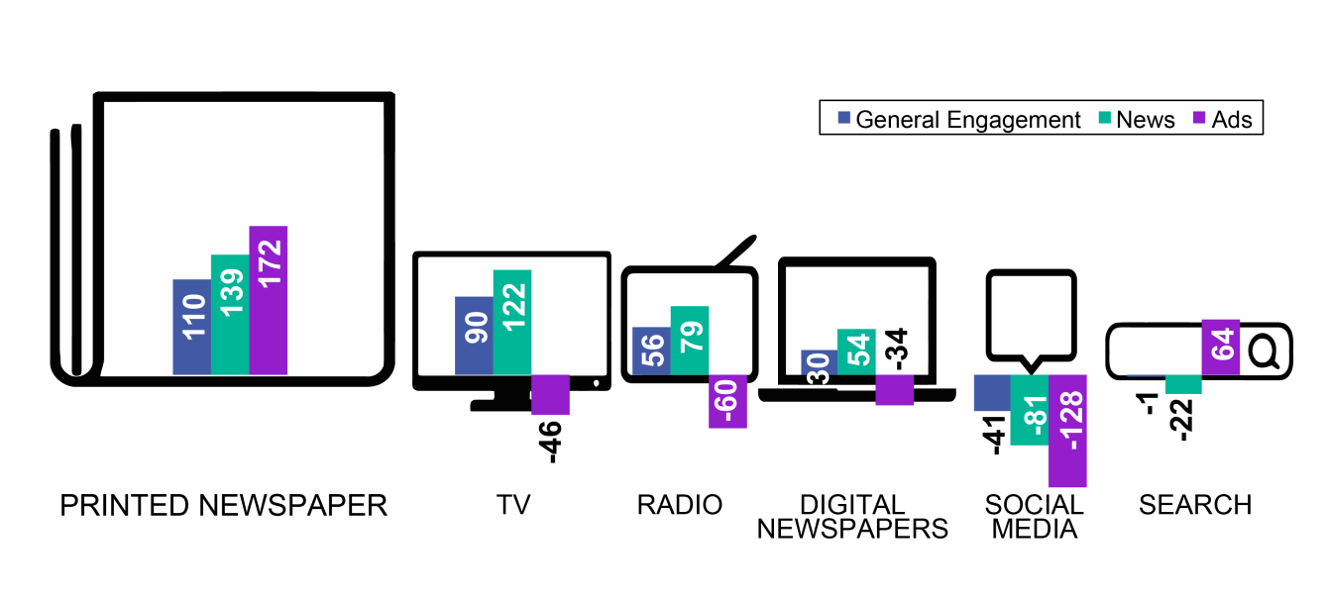
NEWSPAPERS ENGAGE BOOMERS
Boomers are most engaged with traditional media. Advertising in Printed Newspapers engages Boomers more than any other media.
Boomers
Top 3 Traditional Media
Top 3 Digital Media
49% of all Google searches are “no click”
INDEX 100 =
Average
Totum Research, Boomers; June 2019
Notes:
(based on Index of all media measured averaged)
General Engagement = 7 statements (Appendix)
News Engagement = 5 statements (Appendix)
Ad Engagement = 4 statements (Appendix)
Strong Ad Engagement index for Search is primarily influenced due to the response to statement
“It is the best place to get useful information about sales, store hours and special offers” = 37/14 average all media (Index 270)
However, recent research finds that 49% of all Google Searches are “no click”
https://searchengineland.com/49-of-all-google-searches-are-no-click-study-finds-318426

Slide 19
NEWSPAPERS ARE EFFECTIVE FOR BOOMERS
NOTICE ADS
ANNOYED BY ADS
AD EFFECTIVENESS
Boomers
Printed and digital newspaper ads have the only positive effectiveness score for Boomers.
Annoyance by ads reduces effectiveness of other media.
Totum Research, June 2019. Based on Index (100 = Average). Boomers. Ten media measured.
Notes:
BOOMERS Notice Ads - Annoyed by Ads = AD EFFECTIVENESS
Printed Newspapers 169-71=97 AD EFFECTIVENESS
TV 176-213=-37 AD EFFECTIVENESS
Radio 99-125=-26 AD EFFECTIVENESS
Digital Newspapers 83-78=6 AD EFFECTIVENESS
Social Media 119-214=-96 AD EFFECTIVENESS
Search 100-124=-24 AD EFFECTIVENESS

Slide 20
GROWTH IN NEWS MEDIA READERSHIP
Access to digital news platforms has only increased Canadians’ access to news content, and consequently more Canadians than ever are reading news media, in print or digital formats.
2019 weekly readership was 88%
2012 weekly readership was 85%
NINE OUT OF TEN
Canadians (88%) read news media brands each
week in 2019.
READERSHIP
Totum Research; Canadians 18+, weekly readership, March 2019
Notes:
Nine out of ten Canadians (88%) read news media brands every week in 2019. In 2012 weekly readership was 85%.
Access to digital news platforms has only increased Canadians’ access to news content, and consequently more Canadians than ever are reading news media brands, in print or digital formats.

Slide 21
LOCAL INFORMATION IS THE MAIN REASON FOR READING COMMUNITY NEWSPAPERS
HALF OF READERS ALSO READ FOR THE ADVERTISING.
Totum Research, Canadians 18+, Readers of Community Newspapers in Print and/or Digital Platforms, June 2018
Notes:
We continue to explore the reasons for reading community newspapers and one thing never changes. Local information (in many forms) continues to be the driving reason for readership of community newspapers. This study asked about both print and digital formats for an expanded list of different types of local information including:
Local news
Local editorial
Local sports
Local entertainment
Local events
Local crime features
Obituaries
After local information about half are reading for the advertising – this includes ROP ads throughout the paper as well as Flyers/Inserts. Slightly more print readers choose advertising and that is likely attributed to Flyers and Inserts.
And finally, we are still seeing readership of classified ads as well as employment/careers and real estate in community newspapers.

Slide 22
NEWS MEDIA ADS ARE MOST TRUSTED
Ads in printed newspapers are trusted more than any other format.
And advertising on news media websites is the most trusted digital format.
Totum Research, Canadians 18+; June 2019
Notes:
Ads in printed newspapers continue to be the most trusted of all ad formats, results we see study after study. More than half of adults trust printed newspaper ads.
Ads in digital newspapers top the list of trusted digital ad formats and are equally as trusted as ads in traditional media like radio and television. Four out of ten adults completely or somewhat trust ads in digital newspapers.

Slide 23
NEWS MEDIA ADS INSPIRE ACTION
63%
57%
37%
54%
50%
32%
Totum Research, Canadians 18+; June 2019
Notes:
News media ads (in print or digital formats) generate awareness among almost two thirds of readers (63%).
- Three quarters of awareness is generated from print ads (34 print + 15 both = 49% out of 63% total = 77% of awareness generated by printed newspaper ads.

Slide 24
STUDY DESIGN
Study 800 Canadians surveyed online by Totum Research
Timing February 2019 fieldwork
Scope National: English and French Canada
Targets Age, gender and regional targets were applied to ensure valid representation.
Index Index based on percentages of “A” rating (defined as higher than 7 out of 10) for each characteristic compared to the average for all media tested. Scores >100 are better than average, <100 are worse than average and negative scores are more than 100% worse than average.

Slide 25
MEDIA ENGAGEMENT METHODOLOGY
16 characteristics were tested.
General Engagement statements (7)
News Engagement statements (5)
Advertising Engagement statements (4)
Ratings Methodology
Respondents were asked which media they would give an “A” rating (higher than 7 out of 10).
An index was created based on the percentages rating each characteristic with an “A” rating compared to the average for all media tested.
Ten media were measured.
Newspapers (printed/digital)
Television (traditional/digital)
Radio (traditional/digital)
Magazines (printed/digital)
Social Media
Online Search
Notes:
The questionnaire asked 16 engagement questions in 3 different categories.
Ten different media (traditional and digital) were measured.
Respondents were asked which media they would give a “A” rating (higher than 7 out of 10). An index was created based on the ratings % compared to the average rating % for all media measured (combined).

Slide 26
DEFINITIONS OF ENGAGEMENT
GENERAL ENGAGEMENT
NEWS ENGAGEMENT
AD ENGAGEMENT
It is trustworthy.
I feel a personal connection with the medium.
It inspires me.
It makes my life better.
It enhances my interaction with others.
It operates in an ethical manner and has the public’s best interest in mind.
I go to the medium when I have time to myself.
The news it contains comes from reliable sources.
It employs well-trained and knowledgeable journalists.
It provides the news impartially.
Its news content is believable.
It contains informed commentary.
I usually notice ads in this medium.
The ads it contains make me more likely to purchase.
It is the best place to get useful information about sales, store hours and special offers.
It contains annoying ads (Note: Less annoying earner higher engagement scores)

Slide 27
ENGAGED READERS AND EFFECTIVE ADVERTISING
Notes:
www.newsmediacanada.ca
Kelly Levson, Director of Marketing and Research
klevson@newsmediacanada.ca

