Slide 2
Local information keeps readers connected to their communities.
Every week community newspapers shine an unfiltered light on their community and reflect the community back to residents, warts and all. This means attending meetings, often being the only reporter in the room, and prodding public officials with difficult questions. It means celebrating achievements and sharing sorrow. It means being there and being relevant.
Nine in ten (92%) printed community newspaper readers cite local information as their main reason for reading. In many cases local coverage cannot be found anywhere else.
Source: Totum Research, Canadians 18+; Readers of Printed Community Newspapers; December 2022.
*Local information = local news, editorial, sports, entertainment/events, COVID-19, crime features, obituaries
Notes:
Local information keeps readers connected to their communities
Local news continues to be a driving force for newspaper engagement, for readers, and advertisers.
Every week community newspapers shine an unfiltered light on their community and are solely dedicated to telling the stories of the community.
More than eight in ten readers (92%) cite local information as their main reason for reading, including local news, editorial, sports, entertainment and events. And in many cases, that local coverage cannot be found anywhere else.
And half of readers (49%) are reading for the advertising in their community newspapers, including flyers and inserts. And three-quarters of newspaper readers (74%) believe supporting the advertisers in their local newspapers is important.
If you need a reason why advertising in the local paper matters, look at the community stories told in the newspaper and on their websites and their efforts supporting all local businesses, in good times and bad.
Whether in print or online, advertising in a community newspaper is a tried and true way to generate and grow business. It is a partnership to grow the community and invest in those who live, work and play there.

Slide 3
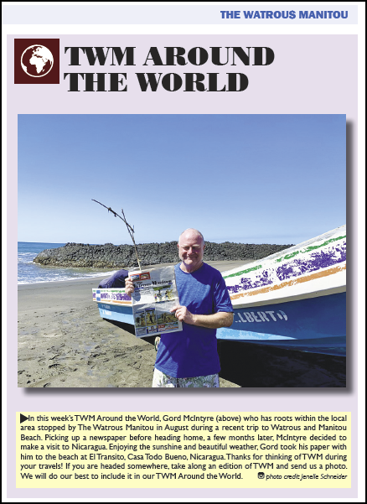
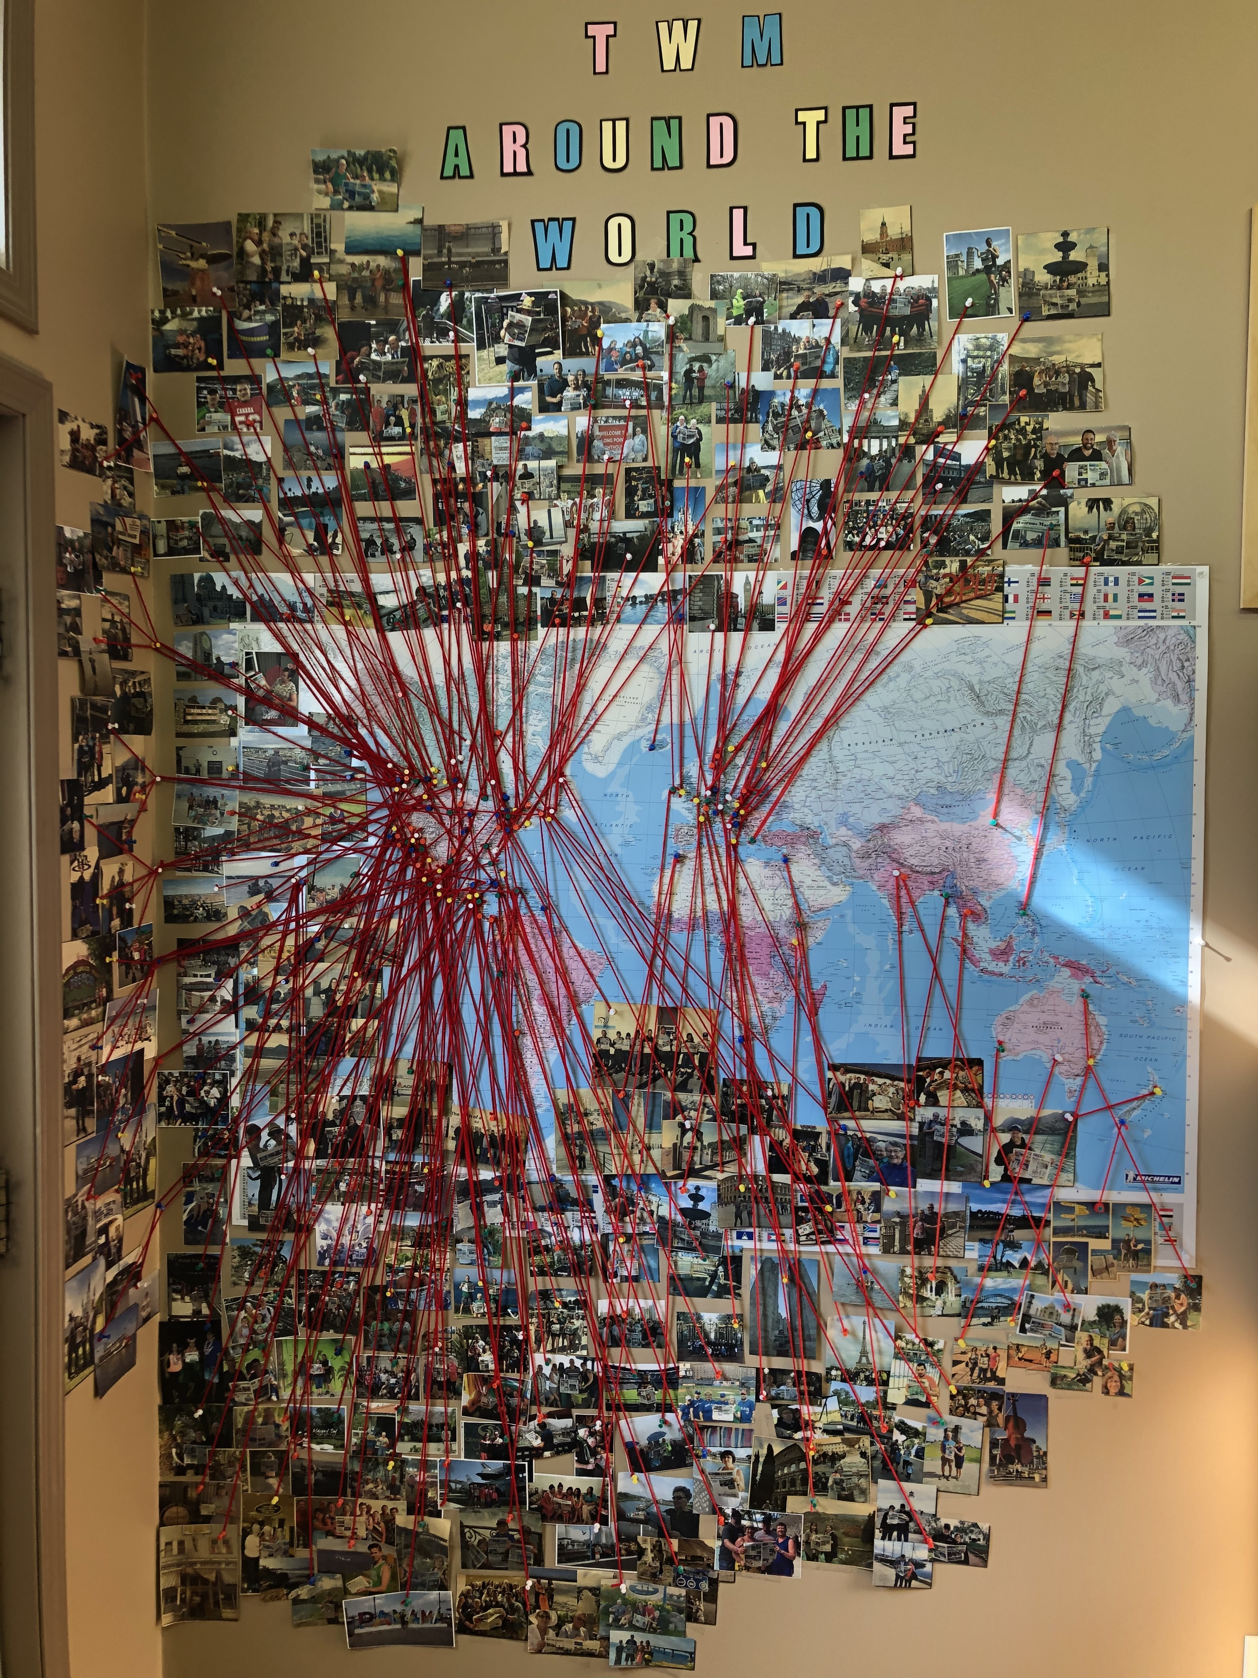
Local Reader Feature TWM Around the World The Watrous Manitou (SK)
A map in the newspaper office tracks where readers have been with their newspaper!
Loyal readers take a copy of The Watrous Manitou on their travels to take a picture with the paper at their destination. A dedicated feature appears in the printed newspaper.
Notes:
Owners Daniel and Kim Bushman created a unique local feature, 𝑻𝑾𝑴 𝑨𝒓𝒐𝒖𝒏𝒅 𝒕𝒉𝒆 𝑾𝒐𝒓𝒍𝒅, launched a few years ago before the pandemic. Loyal readers take along a copy of The Watrous Manitou on their travels in order to take a picture with the paper at their destination. A dedicated feature that appears in the newspaper and on social media and a map in the newspaper office tracks where people have been with their local newspaper. The Watrous Manitou has been photographed all over the globe in destinations like the Great Wall of China, the Eiffel Tower, the Leaning Tower of Pisa, and in countries including England, Mexico, New Zealand, Australia, Russia, the United States and even during a safari in Africa. There are also a few photos taken with celebrities like singer Johnny Reid, curler Kevin Martin, and the late Walter Gretzky at the Hockey Hall of Fame. You can find more information about The Watrous Manitou at https://swna.com/newspaper/watrous-manitou/

Slide 4
“When we put together each edition we focus on local stories, no filler. When you flip through our pages you’ll notice the amount of news content that we write ourselves in-house. I believe in local journalism and continue to be amazed by what a talented team we have.
I believe as a newspaper it is our job to be the storytellers of our communities. We focus on stories that highlight the talented, unique and diverse people who live and work in this wonderful area.
Thank you for buying a subscription, as those dollars go directly to helping us keep telling the wonderful stories of the area.
And thank you to the advertisers who recognize that the community newspaper is in fact still the best way to reach local customers. If you advertise with us you are helping pay the wages of our local employees who shop at our local businesses, helping us pay local taxes, and directly helping us to tell amazing stories and promote the area. We could not do this without your support.”
Ryan Nesbitt, Publisher
Crossroads This Week, Shoal Lake, MB

Slide 5
Canadians believe supporting small business is important to keeping the economy healthy.
In good times and bad times, local advertisers turn to their local newspapers to sustain and grow their businesses.
Newspapers have an unwavering commitment to serving and supporting their readers and the businesses that sustain those communities.
Three quarters of newspaper readers (74%) believe it is important to support the advertisers in their local newspapers.
Source: Totum Research, Canadians 18+; November 2019.

Slide 6
Every time Canadians choose to shop at a small business, they ensure the viability of their communities.
Shopping at a small business enables it to give back, whether it’s by hiring apprentices, sponsoring local hockey teams or donating to food banks. Two-thirds of your dollar helps keep our economy thriving and your community vibrant.
Source: Canadian Federation of Independent Business (CFIB) 2023 #SmallBusinessEveryDay
Notes:
https://www.cfib-fcei.ca/en/media/66-cents-of-every-dollar-spent-at-a-small-business-stays-local-versus-only-11-cents-spent-at-a-multinational-retailer

Slide 7
“Canadians assume the local contributions by large retailers and small businesses are on par, but the difference is significant. The importance of what shopping local means to our communities can’t be stressed enough.
Small businesses support a whole local ecosystem. They source their goods and services from other local businesses in a way the retail giants just don’t.”
Ryan Mallough,
CFIB Vice-President of Legislative Affairs for Ontario

Slide 8
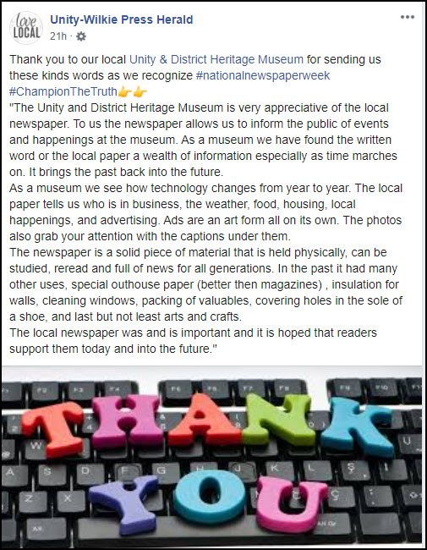
Advertiser Support Campaign (National Newspaper Week) Unity-Wilkie Press Herald, (SK)

Slide 9
“Local journalism is vital to our democracy. It keeps communities informed and connected.
As we have seen throughout the pandemic, in this era of fake news, it is more important than ever before that Canadians have access to trusted, fact-based information.”
Paul Deegan
President and CEO, News Media Canada

Slide 10
When local papers report on news in the community, readers know it is not social media gossip.
60% of Canadians trust printed or digital newspaper content.
Editorial content in newspapers and their digital products, is the most trusted. This level of trust extends to advertising also, creating a “safe” space for readers and advertisers.
54% of Canadians trust editorial content in printed newspapers compared to only 21% trust in social media content.
Source: Totum Research, Canadians 18+; December 2022; n=2755.
Notes:
Editorial content in printed newspapers is the most-trusted of all media, and content on news media websites is the most trusted of digital formats. Combined, 61% of Canadians trust printed or digital newspaper content.
So, despite the general downward pressure from what are viewed as less reliable distribution platforms, newspapers remain a safe space for readers in print and digital formats.

Slide 11
Advertiser Support Campaign (National Newspaper Week) Estevan Mercury (SK)

Slide 12
“Local news unites communities.
For cities, it is about navigating pressing economic issues and politics and the demand is high.
For our smaller communities and rural locations, it is about supporting local businesses, education and community events.”
Sarah Thompson
President, Dentsu Media
CMDC Media Leader of the Year 2020
Notes:
https://the-message.ca/2021/09/29/cmdc-calls-for-more-local-media-investment/

Slide 13
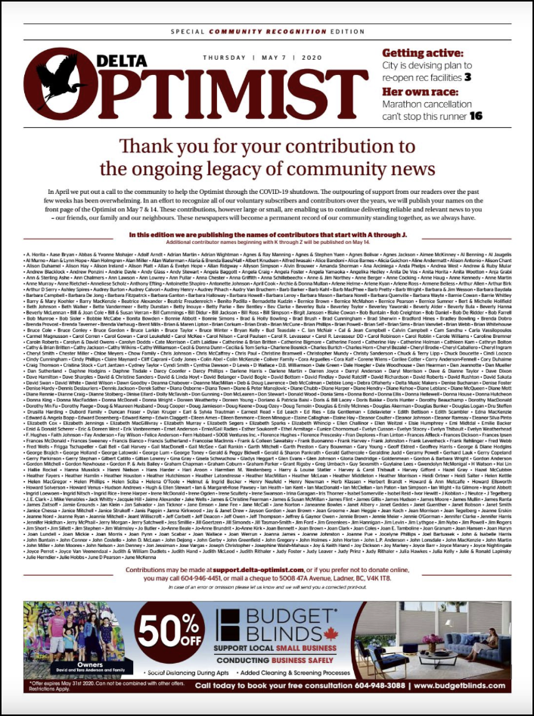
“Make Your Mark on History” Local Support Campaign Delta Optimist (BC)
Notes:
https://nmc-mic.ca/2020/05/14/innovative-campaign-looks-to-recognize-local-supporters/
Across the country, news media organizations are fighting for survival in the wake of the COVID-19 pandemic and many publishers are looking to their communities for support. The Delta Optimist (B.C.), a Glacier Media newspaper, came up with an innovative campaign called Make Your Mark on History to recognize and reward local supporters, readers and advertisers.
The campaign objective was to send out a call to the community for contributions to help the paper get through COVID-19. House ads with different messaging ran through the month of April 2020, in addition to supporting editorial coverage.
Publisher Matt Blair noted “we were very selective about placement as we know different people interact with our paper for different reasons”. The ads ran once on the back page, once as a right hand page facing the flyers and once as a message on the front page.
“All individual readers who contribute to the on ongoing legacy of community news in South Delta will be honoured with their names published on the front page of The Optimist on May 7th. Your contribution, however large or small, will enable us to continue delivering reliable and credible news to you – our friends, our family and our neighbours. This newspaper will become a permanent record of our community standing together, as we always have.”
Blair reinforced that it was vital that readers were provided with a way to contribute via traditional mail or phone, not just online. Given the higher average age of contributors, it was not surprising that well over half of contributions came via phone and mail.
To recognize all supporters (including voluntary subscribers and contributors) the Optimist planned to publish a front page “Thank You” listing everyone’s names. The outpouring of support was so overwhelming that they had to publish names starting with A through J on May 7 and then names starting with K through Z on May 14. In total they will thank more than 1,350 contributors. As a result of the first “Thank You” cover they experienced a continued outpouring of support through letters and additional financial contributions.
The paper also ran a full page thanking advertisers, listing them all by name in addition to some logos. Going forward the paper plans to run letters from prominent community leaders (including the former mayor, head of the Rotary, local Chamber executive director), who all know the value of community news. Each letter will also include a note on how readers can continue to contribute.
Blair gives credit “to those who stewarded this amazing newspaper through the past 98 years. It’s their dedication to the community that has resulted in this outpouring of support through our most trying time. The success of this campaign really speaks volumes to the value of the Optimist’s newsroom and the dedication of those editors and publishers who came before me.”

Slide 14
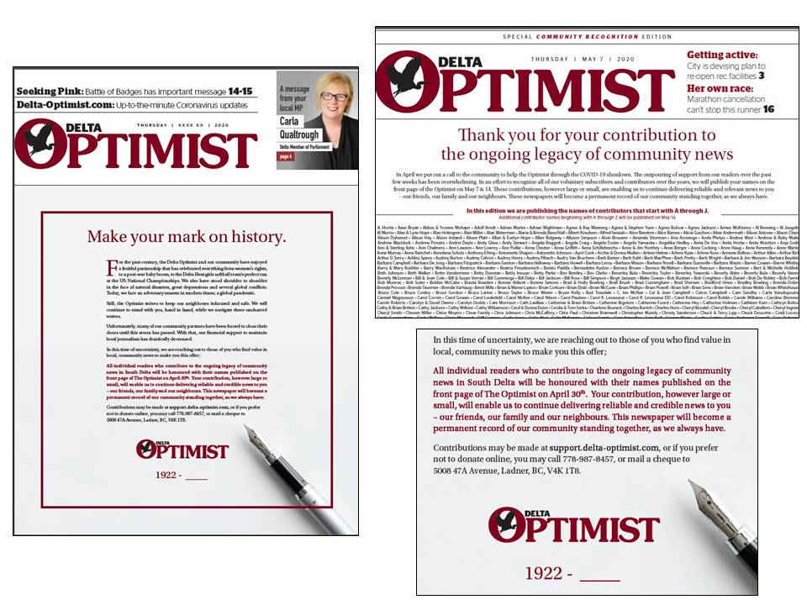
“Make Your Mark on History” Local Support Campaign Delta Optimist (BC)
Notes:
https://nmc-mic.ca/2020/05/14/innovative-campaign-looks-to-recognize-local-supporters/
Across the country, news media organizations are fighting for survival in the wake of the COVID-19 pandemic and many publishers are looking to their communities for support. The Delta Optimist (B.C.), a Glacier Media newspaper, came up with an innovative campaign called Make Your Mark on History to recognize and reward local supporters, readers and advertisers.
The campaign objective was to send out a call to the community for contributions to help the paper get through COVID-19. House ads with different messaging ran through the month of April 2020, in addition to supporting editorial coverage.
Publisher Matt Blair noted “we were very selective about placement as we know different people interact with our paper for different reasons”. The ads ran once on the back page, once as a right hand page facing the flyers and once as a message on the front page.
“All individual readers who contribute to the on ongoing legacy of community news in South Delta will be honoured with their names published on the front page of The Optimist on May 7th. Your contribution, however large or small, will enable us to continue delivering reliable and credible news to you – our friends, our family and our neighbours. This newspaper will become a permanent record of our community standing together, as we always have.”
Blair reinforced that it was vital that readers were provided with a way to contribute via traditional mail or phone, not just online. Given the higher average age of contributors, it was not surprising that well over half of contributions came via phone and mail.
To recognize all supporters (including voluntary subscribers and contributors) the Optimist planned to publish a front page “Thank You” listing everyone’s names. The outpouring of support was so overwhelming that they had to publish names starting with A through J on May 7 and then names starting with K through Z on May 14. In total they will thank more than 1,350 contributors. As a result of the first “Thank You” cover they experienced a continued outpouring of support through letters and additional financial contributions.
The paper also ran a full page thanking advertisers, listing them all by name in addition to some logos. Going forward the paper plans to run letters from prominent community leaders (including the former mayor, head of the Rotary, local Chamber executive director), who all know the value of community news. Each letter will also include a note on how readers can continue to contribute.
Blair gives credit “to those who stewarded this amazing newspaper through the past 98 years. It’s their dedication to the community that has resulted in this outpouring of support through our most trying time. The success of this campaign really speaks volumes to the value of the Optimist’s newsroom and the dedication of those editors and publishers who came before me.”

Slide 15
Shop Local Campaign World-Spectator, Moosomin (SK)

Slide 16
We Love Local Campaign Crossroads This Week, Shoal Lake (MB)
Notes:
You’ve heard the phrase “Shop Local” before, but do you know what it really means for your community?
Shopping local means buying groceries in town rather than running to the city, it means shopping at your local hardware store rather than ordering on Amazon, it means running an ad in the local newspaper rather than just posting on Facebook.
When we support local, we are supporting a local family. Our local businesses and entrepreneurs are the life of our communities. They pay local taxes and create local jobs.
Supporting local literally helps business owners put food on their table, it keeps kids in our schools and in our sports programs. Spending local means businesses have money to donate back to community groups. Amazon and Facebook don’t do that.
Quite simply, the money we choose to spend here, stays here. And the reality is every dollar spent online leaves our area and is never coming back.
If the state of our world has taught us anything maybe it is the value of community. We need each other, and we rely on each other. So let’s support each other. Together, we can keep our business community strong in these hard times and beyond.
The question isn’t, why shop local?
The real question is what happens to our area if we don’t?

Slide 17
“Research shows that communities without a newspaper performing the basic watchdog duty of keeping the people’s business in the light of day have higher crime rates, less government transparency, and higher taxes.
An essential element of a newspaper’s DNA is to bring governmental activities to the attention of citizen taxpayers.”
Leonard Woolsey
President, Southern Newspapers
Publisher, The Daily News in Galveston (TX)
Notes:
https://www.editorandpublisher.com/stories/time-for-newspapers-to-get-their-swagger-back,240881

Slide 18
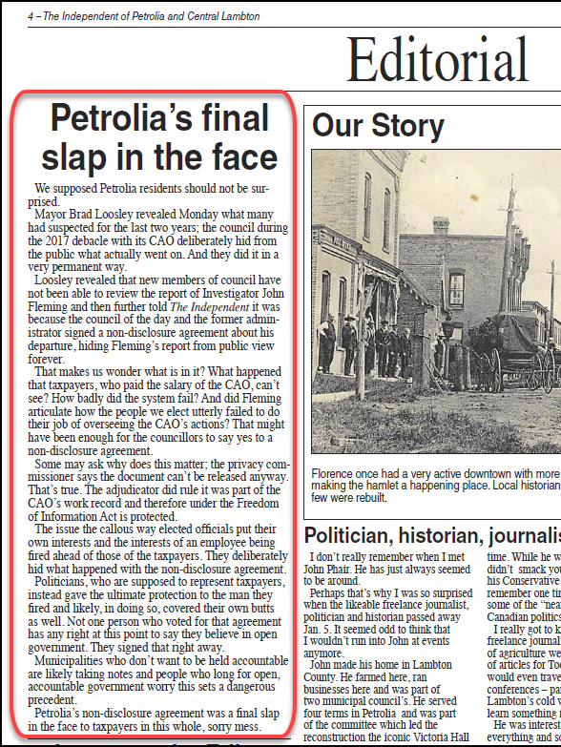
Best Local Editorial CCNAward 2020 The Independent, Petrolia (ON)

Slide 20
“Fact-checked, investigated, accountable truths – the stories that inform civil discourse, how we vote, what is happening in schools, hospitals, in the offices of influence, and on our streets – this comes from journalists – real people putting in a ton of effort to keep citizens informed.”
Jordan Bitove
Publisher, Toronto Star & Owner, Torstar Corporation/
CEO, NordStar Capital
Notes:
https://carleton.ca/sjc/23rd-annual-kesterton-with-jordan-bitove/

Slide 21
Champions Font
This presentation has been produced with the new Champions font, developed in 2022 to celebrate and support the news media industry.
Champions is a geo-humanist font incorporating:
humanistic traits — which mimic hand motions reflecting the craft and artistry that goes into producing credible news each day; and
highly geometric shapes —which represent the structure and rigour of fact-checking, editing, and producing high-quality credible content newspapers are known for.
Show your support for the industry and download the Champions font at www.nationalnewspaperweek.ca
Notes:
Inspired by the essential service that newspapers provide, the Champions font highlights the power of words, and the people behind the press, who use them to communicate essential information to Canadians each and every day. These Champions of the Truth keep our democracy thriving through a vibrant and independent news media.
To celebrate National Newspaper Week 2022, News Media Canada has created a custom font entitled, “Champions”, available for free download. Designed with both print and digital platforms in mind, the Champions font honours newspapers' history while looking forward to a bright and multi-platformed future.

