Slide 1
Newspapers Across Devices

Slide 2
Fast Facts
Newspaper Readership Across Devices
Engagement
Newspapers Drive Purchase Decisions
Multimedia Strength
Print
Digital

Slide 3
Newspaper Readership Across Devices

Slide 4
Newspaper Readership Across Devices - Print Solid
9 in 10 read a newspaper on any device each week
7 in 10 read a print newspaper each week
6 in 10 read on a newspaper website each week
5 in 10 read a newspaper on the phone each week
5 in 10 read a newspaper via a tablet each week
Totum Research on behalf of Newspapers Canada; “Newspapers 24/7 – What’s Changed”, November 2014

Slide 5
Readership Across Multiple Media – Strong Over Time
86
87
85
Readership by device in same order as in 2011
Print & phone holding; website & tablet up a little
68
Totum Research on behalf of Newspapers Canada; “Newspapers 24/7 – What’s Changed”, November 2014

Slide 6
Readership By Time of Day
Print – Morning (strongest) + Evening
Tablet – Evening
Web & Phone – Early AM + Mid-AM + Evening (web!)
Totum Research on behalf of Newspapers Canada; “Newspapers 24/7 – What’s Changed”, November 2014

Slide 8
Newspaper Readers are Engaged
46 minutes per day with paper copies
30-40 minutes per day with digital versions
NADbank, April 22, 2015

Slide 9
Media Engagement*
Print newspapers are #1 - outperforming all other media
Newspaper sites also score well above average
*Definition: Media Engagement
Measured on 11 metrics: trust, connection with the medium, inspiration, ethical, go-to medium when have time, notice ads, ads increase purchase likelihood, useful info in ads & annoying ads
Totum Research on behalf of Newspapers Canada, “ Media and Advertising Engagement Research Summary”, April 2014

Slide 10
Engaging Media: Newspapers & Websites
An average score = 100
Print newspapers scored highest - twice the average
Newspaper website scored 34% higher than average
100
(Average)
* Media engagement measured on 11 metrics: trust, connection with the medium, inspiration, ethical, go-to medium when have time, notice ads, ads increase purchase likelihood, useful info in ads & annoying ads.
Totum Research on behalf of Newspapers Canada, “ Media and Advertising Engagement Research Summary”, April 2014

Slide 11
Ad Engagement*
Print newspapers are #1
Newspaper sites are #2
Both outperform all other media
*Definition: Ad Engagement
Measured on 4 metrics: notice ads, ads increase purchase likelihood, useful info in ads & annoying ads. All engagement scores were added except ‘it contains annoying ads’ which was subtracted (as it is a negative attribute). In some cases, this created a negative score.
Totum Research on behalf of Newspapers Canada, “ Media and Advertising Engagement Research Summary”, April 2014

Slide 12
Most Engaging Ads: Newspapers & Websites
An average score = 100
Print newspapers scored highest – almost 5 times the average!
Newspaper website scored 39% higher than average
100
(Average)
* Ad engagement measured on 4 metrics: notice ads, ads increase purchase likelihood, useful info in ads & annoying ads. All engagement scores were added except ‘it contains annoying ads’ which was subtracted (as it is a negative attribute). In some cases, this created a negative score.
Totum Research on behalf of Newspapers Canada, “ Media and Advertising Engagement Research Summary”, April 2014

Slide 13
Newspapers Drive Purchase Decisions

Slide 14
Newspapers are the number # 1 resource for Canadians when they are making a purchase decision.
Totum Research on behalf of Newspapers Canada, “Newspapers Drive Purchase Decisions”, August 2013

Slide 15
Influencers Drive Purchases Of Others
(and they read newspapers in print & digital)
“Influencers are information hounds …these people are more heavily represented in the audiences for print media, and online publishers, more so than in the audiences of Facebook and Twitter…target influencers through the media they use”
“How Influence Works”, Admap

Slide 16
Newspaper readers across devices are more aware of the ads, and have better brand recall.
Inma.org, “Digital newspaper: same advertising impact and so much more”, March 26, 2013

Slide 17
Multimedia Strength
Print

Slide 18
Print Newspapers: Trusted & Idea Source
Beat out all other media:
Newspapers ads are trusted
The idea source for shopping trips: newspapers & flyers
Nielsen 2014, BrandSpark/BH&G, February 2013

Slide 19
7 in 10 Canadians Take Action after Seeing a Newspaper Ad
Became aware of a product or service
Looked for more information
Visited a store in-person or online
Made a purchase
Referred the ad to someone else
Totum Research on behalf of Newspapers Canada; Canadians 18+; November 2013

Slide 20
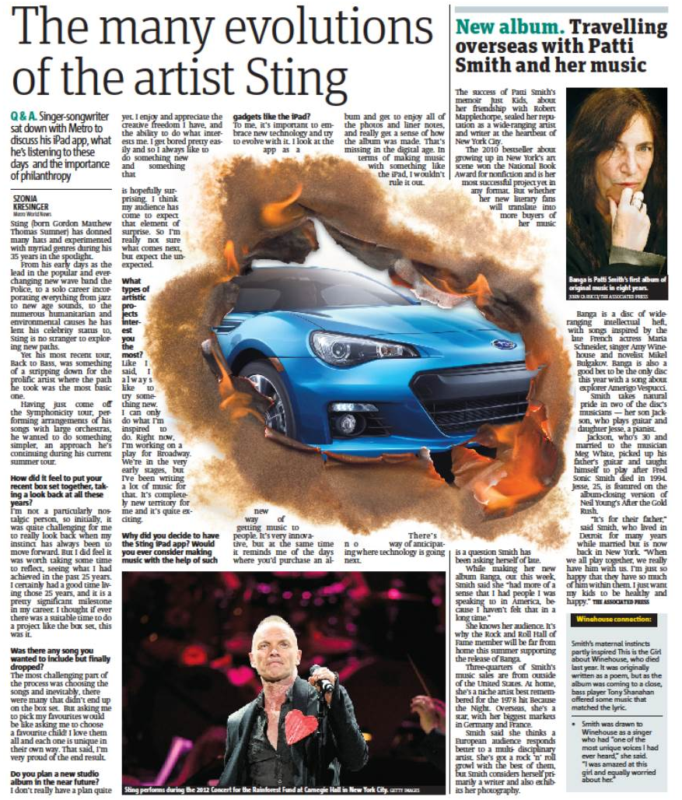
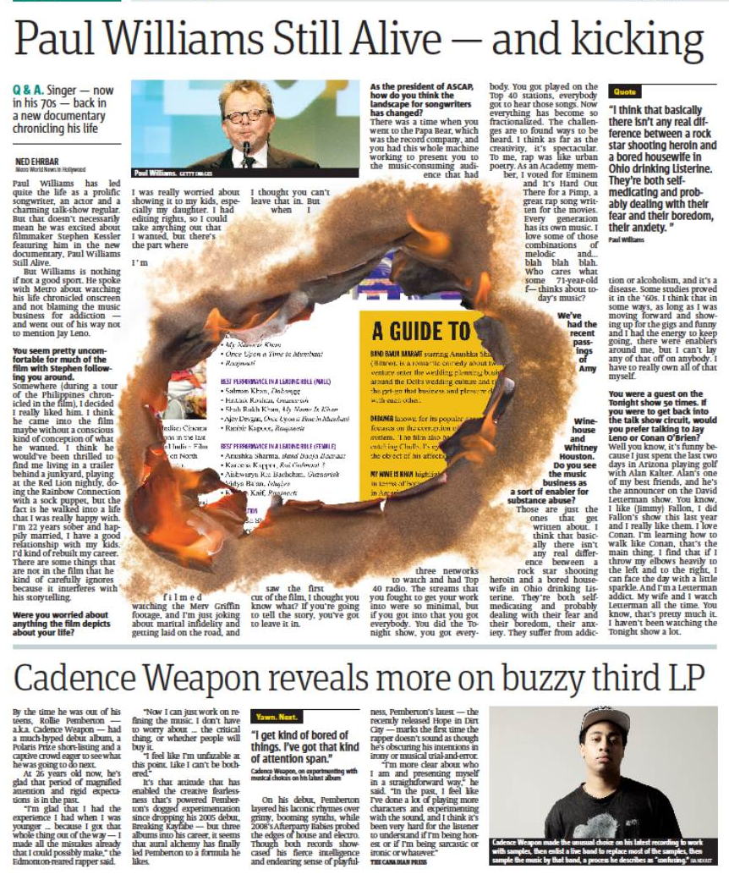
Brand: Subaru BRZ sports model
Plan: Demonstrate “hotness” (live editorial surrounds)
Results: Entire production line sold out in 6 months

Slide 21
Brand: SunSense (SPF + ingredients to prevent wrinkles), Australia
Plan: Only used newspapers:1-3 times/week for 4 weeks
Results: “It was a frenzy!” Sold a year’s worth in 3 weeks

Slide 22
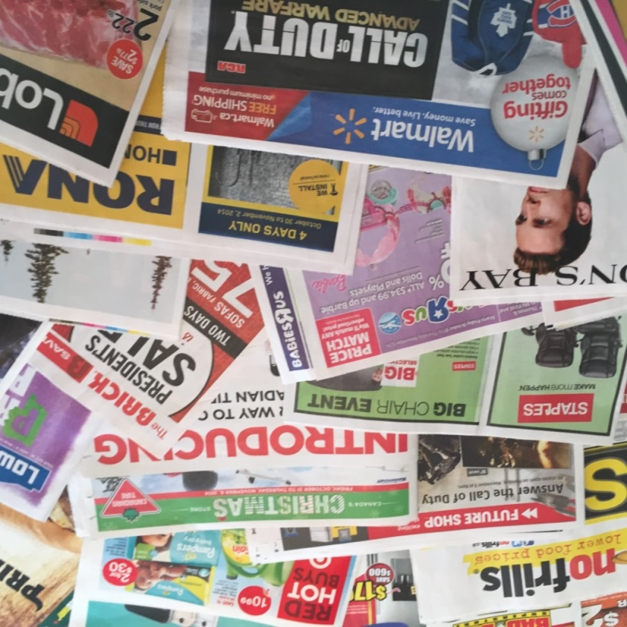
Canadians Embrace Flyers
90% of Canadians welcome flyers
8 in 10 read the print flyer
6 in 10 read the online flyer
Flyer Distribution Standards Association undertaken by Totum Research 2014
(Flyers: Which of the following do you read, look into or access?)

Slide 23
Print Newspapers Are Green
Biodegradable Time Line
6 weeks 5,000 years 1 million years
National Parks Service 2015

Slide 24
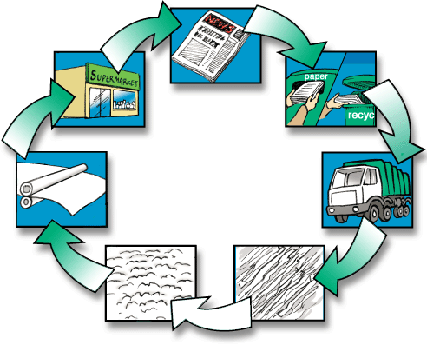
Print Newspapers Are Green
In Canada, over 85% of newspapers are recycled
Waste Diversion Ontario 2015

Slide 25
Multimedia Strength
Digital

Slide 26
Reading Newspaper on Tablet
Nine out of 10 enjoy the tablet edition
Two-thirds read almost every page
Tablet ad impact just as powerful as print
Video ad recall is 27% higher on tablets vs TV
Inma.org, “Digital newspaper: same advertising impact and so much more”, March 26, 2013; gigaom, “ Viewers recall ads best when they watch them on tablets: Study”, Aug. 23, 2013

Slide 27
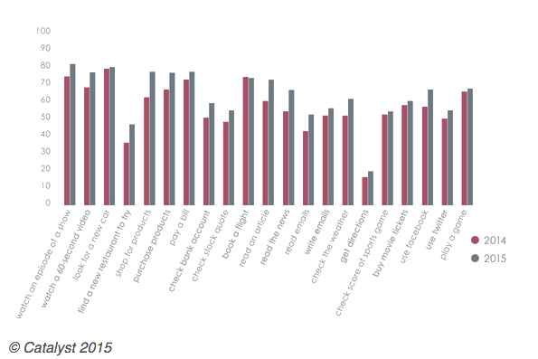
News Read On Mobile Phone
+39%
Out of 21 mobile activities, reading an article/news grew, matching Facebook & gaming
8th
9th
itbusiness.ca, “Canadian smartphone use on the rise, but apps in decline: report, April 10, 2015

Slide 28
Packaged Goods Giant Believes in Print & Digital
Situation: Undertook a study to determine which media are most effective at generating sales on a per impression basis
Results: From most effective to least:
Print
TV
Digital Display (90% impact of TV)
Radio
Search
Out of Home
They also found that social media buzz had no impact on short-term sales
AdAge, “Buzz kill: Coca-Cola finds no sales lift from online chatter”, March 18, 2013

Slide 29
Augmented Reality allows the newspaper to come to life!
Download an app (i.e. Layar, Blippar), hold the phone over the ad and further information is provided – in this case different boots. As you turn the phone, you can see all sides of the boot.

