Slide 1
2021
www.newsmediacanada.ca

Slide 2
News Media Readership Growth
Access to digital news platforms has only increased Canadians’ access to news content, particularly during the COVID-19 pandemic. Consequently, more Canadians than ever are reading news media, in print or digital formats.
2020 weekly readership was 87%
ALMOST NINE OUT OF TEN
Canadians of all ages read news media brands each week in 2020.
READERSHIP
2012 weekly readership was 85%
Totum Research; Canadians 18+, weekly readership, November 2020
Notes:
Nine out of ten Canadians (87%) read news media brands every week in 2020. In 2012 weekly readership was 85%.
Access to digital news platforms has only increased Canadians’ access to news content, and consequently more Canadians than ever are reading news media brands, in print or digital formats.

Slide 3
Need to Reach Millennials?
New survey results show that nine out of ten Millennials read newspapers weekly in print or digital formats.
90%
87%
82%
Adults 18+
Millennials
Boomers
Total Weekly Newspaper Readership (Print + Digital)
Totum Research; Canadians 18+, weekly readership, November 2020
Notes:
Readership by adults over 18+ over the course of a week comes in at 87%, according to research from November 2020.
This data confirms that Millennials are now the strongest demographic group of readers with 90% reporting print or digital readership over the course of a week. Millennials are defined as those born between 1982 and 1999, making them between 21 and 38 years old in 2020. As this group gets older their reliance on credible news sources only increases.
The pandemic has only increased Canadians’ appetite for news, and Millennials are no different. In fact, 36% of Millennials reported the highest levels of newspaper reading since the start of the pandemic (10% higher than adults 18+). And four out of ten Millennials plan to continue reading newspapers as much post-pandemic.

Slide 4
Different Platforms for Newspaper Content
82% of print readers also read in digital.
79% of adults 35+
77% of adults 55+
70% of digital readers also read in print.
77% of adults 35+
87% of adults 55+
Print reading preference increases with age.
Totum Research, Canadians 18+, 35+, 55+, November 2020
Notes:
Different age groups have different reading habits depending on the platform, and the duplication between print and digital is strong.
Research shows that 82% of print readers (age 18+) are also reading in digital formats. And 70% of 18+ digital readers are also reading in print – this climbs to 87% duplication for adults over 55 years of age. Print reading increases with age.

Slide 5
Print Readers add Digital Access
Millennials are interested in reading news, no matter the platform. Almost all weekly print readers between 21 and 38 years of age choose to add digital newspapers to their print reading habit.
Totum Research, Canadians 18+, November 2020
Notes:
Millennials are interested in reading news, no matter the platform. Almost all Millennial print readers choose to add digital newspapers to their print reading habit. In comparison, 76% of Boomer add digital to their print reading habit.

Slide 6
Local Information is the Main Reason for Reading Community Newspapers
Half of readers also read for the advertising.
Totum Research, Canadians 18+, Readers of Community Newspapers in Print and/or Digital Platforms, February 2019
Notes:
We continue to explore the reasons for reading community newspapers and one thing never changes. Local information (in many forms) continues to be the driving reason for readership of community newspapers. This study asked about both print and digital formats for an expanded list of different types of local information including:
Local news
Local editorial
Local sports
Local entertainment
Local events
Local crime features
Obituaries
After local information about half are reading for the advertising – this includes ROP ads throughout the paper as well as Flyers/Inserts. Slightly more print readers choose advertising and that is likely attributed to Flyers and Inserts.
And finally, we are still seeing readership of classified ads as well as employment/careers and real estate in community newspapers.

Slide 7
Almost Half (46%) of Printed Community Newspaper Readers 18+ Read for Flyers
Flyers help increase top-of-mind awareness among consumers when deciding where to purchase a product, and are pivotal methods of increasing sales and foot traffic across many industries.
More than three quarters of community newspaper readers in Canada use flyers / inserts to plan their grocery purchases.
Nine out of ten flyer readers
prefer them in print.
Totum Research, Canadians 18+, February 2019; Vividata Fall 2020 Study
Notes:
When asked about reasons for reading community papers research consistently shows that almost half of readers cite flyers. A key category for flyers has always been grocery and research also finds that more than three quarters of community newspaper readers use flyers to plan their grocery shopping.
We also know that nine out of ten flyer readers continue to prefer the printed version of flyers. Digital flyers are typically used in addition to the printed version.

Slide 8
Older Demographics More Likely to Read for Flyers
Read Printed Community Newspapers for Flyers/Inserts
52%
53%
More than half of printed community newspapers age 35+ read for the flyers and inserts.
46%
Adults 18+
Age 35+
Age 50+
Totum Research, Canadians 18+, 35+, 55+, February 2019
Readers of printed community newspapers.
Notes:
As age increases so does readership of flyers and inserts. More than half of readers over 35 years of age cite flyers and inserts as one of their reasons for reading printed community newspapers.

Slide 9
News Media Ads Inspire Action
63%
57%
37%
54%
50%
32%
Totum Research, Canadians 18+; Readers of any newspaper in past week; February 2019
Notes:
The combination of print and digital newspaper ads is a powerful tool to inspire action among readers, including awareness, store visits or purchases.
News media ads (in print or digital formats) generate awareness among almost two thirds of readers (63%).
- Three quarters of awareness is generated from print ads (34 print + 15 both) = 49% out of 63% total = 77% of awareness generated by printed newspaper ads.

Slide 10
Printed Newspaper Ads Most Trusted
Ads in printed newspapers are trusted more than any other format.
And advertising on news media websites is the most trusted digital format.
Totum Research, Canadians 18+; December 2020
Out of Home includes billboards, transit shelters, and other outdoor sites.
Notes:
Ads in printed newspapers continue to be the most trusted of all ad formats, results we see study after study. Half of adults (52%) trust printed newspaper ads. Advertising in printed newspapers is not always seen as an interruption. Many studies have shown that one of the reasons adults read printed newspapers is for the ads.
Ads in digital newspapers top the list of trusted digital ad formats and are more trusted than ads in traditional media like radio, television and magazines. Four out of ten (39%) adults completely or somewhat trust ads in digital newspapers.

Slide 11
Reliable Journalism is Crucial
Eight in ten (82%) Canadians feel that reliable journalism is an essential part of a democratic society.
79% are concerned about the repercussions of fake news and it being used as a weapon.
Totum Research, Canadians 18+; February 2020 (SPOT Fake News Online)

Slide 12
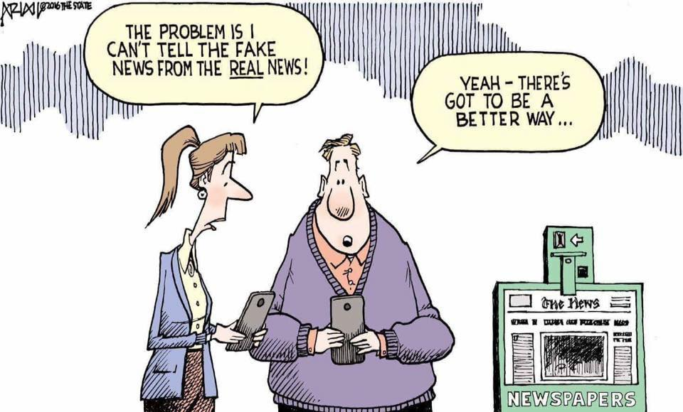

Slide 13
Newspapers Score High On Engagement
Index
When reading a newspaper, Canadians give it their full attention, compared to other media where attention may be fractured.
Canadians were surveyed on 7 metrics for media engagement:
1. It is trustworthy; 2. I feel a personal connection with the medium; 3. It inspires me; 4. It makes my life better; 5. It enhances my interaction with others; 6. It operates in an ethical manner and has the public’s best interest in mind; 7. I go to the medium when I have time to myself.
Totum Research: Canadian Adults 18+ Engaged and Connected, February 2019
Notes:
Newspapers score highest on engagement based on this data from Engaged and Connected (February 2019). Intuitively this makes sense, since reading a newspaper is an active choice rather than a passive background activity.
When Canadians were surveyed on eleven metrics for media engagement, printed newspapers scored highest. When reading a newspaper, Canadians give it their full attention, compared to other media where attention is fractured.

Slide 14
Newspaper Media Reach All Target Groups during COVID-19
Business Decision Makers*, Community Influencers** and adults with household incomes $100K+ read most on their phone but have among the highest overall readership on any platform. All these groups over-index on every platform.
% Weekly Readership
87%
Any Platform
95%
Any Platform
94%
Any Platform
88%
Any Platform
*Canadian professionals, senior management/executives and business owners/self employed
** Influencers – 3+ of the following statements: Find a new product and typically recommend it to others; Keep informed about new products and services; People frequently ask for my advice; Always the first to try new products/services; Frequently share information about products/services on social media
Totum Research; Canadians 18+, weekly readership, November 2020
Notes:
Research from November 2020 confirms that 87% of adults read newspaper content weekly, across a variety of print and digital platforms. COVID has increased the demand for news across all digital platforms. This is most evident with Business Decision Makers (professional, senior managers, executives and business owners) who over index on readership across all platforms; they are news junkies and prefer to access news on-the-go, primarily on their phones. Across all platforms combined 95% of this group are newspaper readers.

Slide 15
Optimized Campaign =
+
78%
TRADITIONAL ADVERTISING
22%
DIGITAL ADVERTISING
While ad dollars are increasingly moving to digital, it’s most effective to keep the bulk of the dollars in traditional media.
“More is better: spending across multiple platforms delivers greater ROI than investing in single platforms.”
Gayle Fuguitt, President, CEO Advertising Research Foundation
Media Life Magazine, April 4, 2016
Notes:
http://www.medialifemagazine.com/finding-an-optimal-mix-between-new-and-old-media/
The Advertising Research Foundation examined 5,000 campaigns, representing $375 billion in spending.

Slide 16
Print Ads Cannot be Blocked
Four in ten (42%) Canadians use some form of ad blocker.
Most frequent ad blocking:
online shopping (74%)
video streaming (73%)
social media (66%)
Totum Research, Canadians 18+, February 2020
Notes:
The good news is that more than 90% of Canadians (higher than the US) but the bad news is that more and more North Americans are using ad blockers. Data from GlobalWebIndex and their Digital Snapshot study (2019) puts ad blocker usage at 44% of North Americans. Ad blocking is similar across all generations, ranging from 29% for GenX to 38% for Boomers.
https://mediaincanada.com/2019/09/19/ad-blocker-usage-at-nearly-50-report/
News Media Canada data gathered in February 2020 finds that four out of ten are using some sort of ad blocker, used most when online shopping, video streaming and browsing social media. This matches what other research finds for Canada – Hootsuite finds that ad blocking in Canada is at 41.3%.
https://backlinko.com/ad-blockers-users#ad-blocking-by-country

Slide 17
Methodology
Timing and Sample Size
February 2019 (n=800)
October 2019 (n=1,000)
February 2020 (n=800)
November 2020 (n=855)
December 2020 (n=847)
Online Panel
Online interviews conducted with adult Canadians
Nationally Representative Sample
Men: 50%, Women: 50%
18-34: 29%, 35-49: 20%, 50-64: 33%, 65+ 18%
West 31%, Ontario 39%, Quebec 23%, Atlantic 7%
National Scope
63% English / 37% French
Study Management
Totum Research
Margin of Error
±3.1% at the 95% confidence level
Notes:
Survey data from News Media Canada research is conducted by Totum Research using online interviews with Canadian adults 18+. Sample sizes range from 800 to 1,000 across various studies conducted between February 2019 and December 2020. All research is nationally representative and weighted to represent StatCan data for gender, age and region.

Slide 18
2021
www.newsmediacanada.ca
Notes:
More information can be found on the News Media Canada website at www.newsmediacanada.ca.
Questions can be directed to Kelly Levson, Director of Marketing and Research at klevson@newsmediacanada.ca.

Slide 19
Appendix

Slide 20
Newspaper Media Reach All Target Groups during COVID-19
More than eight out of ten adults 50+ years of age read newspapers weekly. This group prefers print over all other platforms for their news content.
% Weekly Readership
87%
Any Platform
85%
Any Platform
83%
Any Platform
87%
Any Platform
Totum Research; Canadians 18+, weekly readership, November 2020

Slide 21
News Media Ads Inspire Action
News media generate awareness for more than two thirds of older adults. The majority of awareness is generated from print.
63%
66%
71%
Totum Research, Canadians 18+; Readers of any newspaper in past week; February 2019
Notes:
News media ads (in print or digital formats) generate awareness among almost two thirds of readers (63%).
- Three quarters of awareness is generated from print ads (34% print + 15% both) = 49% out of 63% total = 77% of awareness generated by printed newspaper ads.

Slide 22
News Media Ads Inspire Action
The majority of older adults are inspired to search more information online by printed news media ads.
57%
59%
59%
Totum Research, Canadians 18+; Readers of any newspaper in past week; February 2019
Notes:
News media ads (in print or digital formats) generate online information searches among more than half of readers (57%).
- Six out of ten of adults 50+ are looking for more information online from print ads (24% print + 12% both) = 36% out of 59% total = 61%.

Slide 23
News Media Ads Inspire Action
The majority of older adults are inspired to search more information offline by printed news media ads.
37%
39%
38%
Totum Research, Canadians 18+; Readers of any newspaper in past week; February 2019
Notes:
News media ads (in print or digital formats) generate offline information searches among more than a third of readers (37%).
- Two thirds of adults 50+ are looking for more information offline from print ads (20% print + 5% both) = 25% out of 38% total = 66%.

Slide 24
News Media Ads Inspire Action
News media ads are more effective at generating store visits among older readers. Almost two thirds of readers aged 50+ visited a store as a result of exposure to a newspaper ad.
54%
60%
64%
Totum Research, Canadians 18+; Readers of any newspaper in past week; February 2019
Notes:
News media ads (in print or digital formats) generate store visits (in-person or online) among more than half of readers (54%).
- Almost three quarters of store visits are generated from print ads (38% print + 9% both) = 47% out of 63% total = 73%.

Slide 25
News Media Ads Inspire Action
Newspaper ads are more effective at generating purchases among older adults. Print ads are a key purchase driver.
50%
53%
58%
Totum Research, Canadians 18+; Readers of any newspaper in past week; February 2019
Notes:
News media ads (in print or digital formats) generate purchases among half of readers (50%).
- Three quarters of purchases are generated from print ads (34% print + 10% both) = 44% out of 58% total = 76%.

Slide 26
News Media Ads Inspire Action
Newspaper ads generate referrals among a third of readers, regardless of age.
32%
31%
31%
Totum Research, Canadians 18+; Readers of any newspaper in past week; February 2019
Notes:
News media ads (in print or digital formats) generate referrals among a thirds of readers (32%).
- Three quarters of referrals are generated from print ads (16% print + 4% both) = 20% out of 31% total = 65%.

