Slide 1
Domestic Travel in Canada
www.newspaperscanada.ca

Slide 2
Domestic Vacation Travel in Canada
2016 could be the year of the Canadian “staycation” with predictions of growth in domestic overnight travel by the Conference Board of Canada.
Last year saw an increase of 2.8% and this year we could see further 2.4% growth in overnight travel within Canada due to low gas prices and the struggling loonie.

Slide 3
Domestic Vacation Travel in Canada
Statistics Canada reports that in the third quarter of 2015, the number of domestic trips increased 4.1% from the same quarter in 2014 to 101.0 million.
Total expenditures for those trips rose 6.1% to $17.3 billion.

Slide 4
Domestic Vacation Travel in Canada
More than half of Canadian adults travelled within Canada on vacation in the past 12 months.
These travellers skew female, have an above average household income and are parents.
53%
of adults travelled for vacation within Canada in the past 12 months
Source: Vividata 2015 Q2 Readership and Product Database; Base: 18+ in the 20 reported markets.
Travel in Canada for vacation in past 12 months (including duplication)

Slide 5
Canada Vacation Travellers*
HHI Adults 18+ $84,577
HHI Vacation Travellers $93,028
Female skew
Age 35+ years
Above Average Household Income
Parents
Source: Vividata 2015 Q2 Readership and Product Database
* adults that travelled for vacation within Canada in the past 12 months

Slide 6
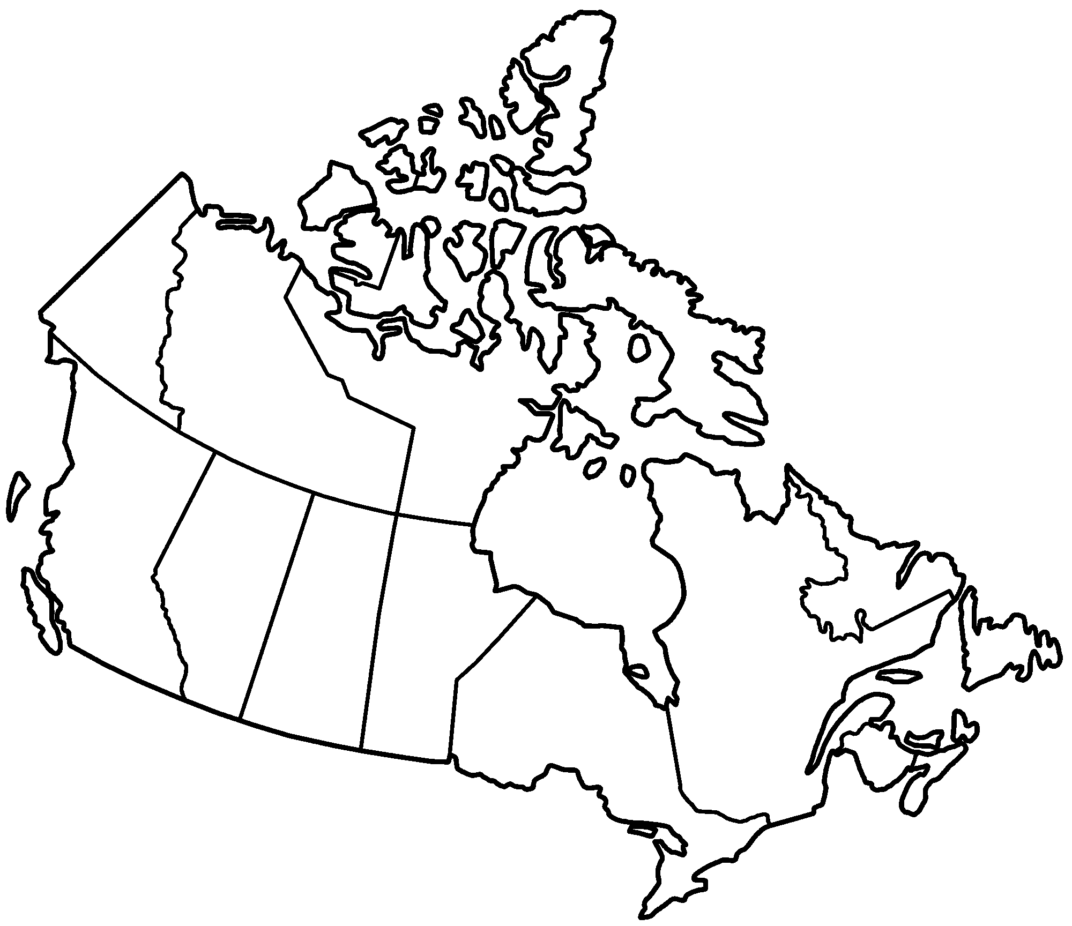
Canada Vacation Travellers
45% of vacation travel destinations are in Western Canada.
22%
BC & North
23%
25%
Prairies
49%
Quebec
Ontario
8%
Atlantic
Source: Vividata 2015 Q2 Readership and Product Database; Base: 18+ in the 20 reported markets.
Travel in Canada for vacation in past 12 months (including duplication)

Slide 7
Domestic Vacation Travel in Canada
Domestic vacation travellers are strong newspaper readers.
More than half (57%) read yesterday’s newspaper; and
More than eight out of ten (81%) can be reached with newspapers over the course of a week.
Source: Vividata 2015 Q2 Readership and Product Database; Base: 18+ in the 20 reported markets.
Travel in Canada for vacation in past 12 months (including duplication)

Slide 8
Domestic Vacation Travel in Canada
These readers enjoy newspapers in both print and digital format, with considerable overlap between the two.
Digital readership is strong but the majority of digital readers still enjoy their printed newspaper habit.
Source: Vividata 2015 Q2 Readership and Product Database; Base: 18+ in the 20 reported markets.
Travel in Canada for vacation in past 12 months (including duplication)

Slide 9
Canadian Vacation Travellers Read Newspapers in Print and Digital
Digital
Readers
3,008,000
Print
and
Digital
Readers
1,609,000
Digital
ONLY
Readers
1,399,000
Print
ONLY
Readers
2,467,000
Print
Readers
4,076,000
Total Newspaper Readers = 5,475,000
Source: Vividata 2015 Q2 Readership and Product Database; Base: 18+ in the 20 reported markets.

Slide 10
Newspapers: Strongest traditional media source for vacation travel services
When domestic vacation travellers are looking for travel services, newspapers and their flyers top the list of traditional media relied upon, as reported by 31% of Canadian travellers.
The Internet now dominates in the travel sector, but when it comes to media reliance for travel services, 95% of these travellers report newspapers (and their flyers), along with the Internet, are their media of choice.
Source: Vividata 2015 Q2 Readership and Product Database

Slide 11
Canada Vacation Travellers* Media Sources for Vacation Travel Services
Newspapers and their Flyers are the strongest traditional media source for vacation travel services
31% of Travellers* rely on Newspapers/Flyers for Vacation Travel Services
Source: Vividata 2015 Q2 Readership and Product Database; *adults that travelled for vacation within Canada in the past 12 months

Slide 12
Canada Vacation Travellers*
Media Sources for Vacation Travel Services
Newspapers and their Flyers are the strongest traditional media source for vacation travel services, alone and in combination with the Internet.
Newspapers/Flyers add 13% reach to Travellers’ reliance on the internet for vacation travel services.
Source: Vividata 2015 Q2 Readership and Product Database; *adults that travelled for vacation within Canada in the past 12 months

