Slide 1
Frequency Works in Newspapers

Slide 2
What is Frequency in Advertising?
In order to get your brand’s advertising message out, you need to reach your consumers a number of times (i.e. frequency).
Too much, and recipients will be saturated.
Too little exposure and audiences will fail to notice the advertising.

Slide 3
How do Consumers Respond?
Across all media, the first couple of exposures to an ad have more impact than later ads - although they do build.
Industry research tracked frequency of newspaper ads.
Aided awareness of advertised brands was noted and compared to those with no exposure to the advertising.
The impact of newspaper ad frequency was significant!

Slide 4
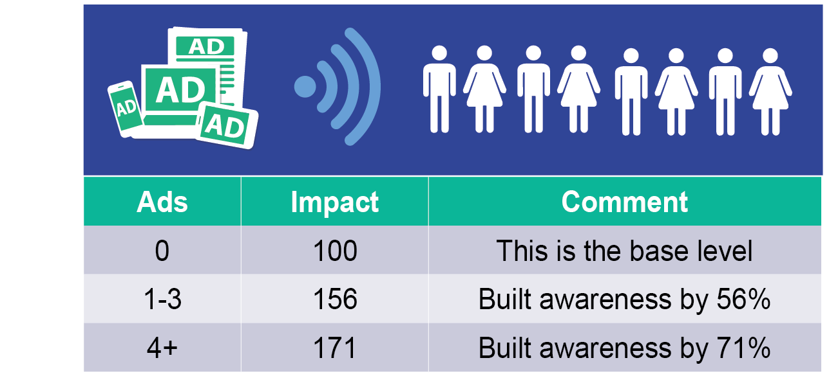
Significant Impact with Newspapers
Four or more newspaper ads increased awareness by 71%.

Slide 5
Frequency in Newspapers Works!
Newspaper advertising for Mitsubishi was very effective, particularly for those exposed to the message more often.
Source: Totum Research, November 2012

Slide 6
Frequency in Newspapers Works!
Newspaper advertising for Mitsubishi was very effective, particularly for those exposed to the message more often.
Index
Source: Totum Research, November 2012

Slide 7
What About Driving Sales?
Good advertising can result in
consumer purchases.
“There is convincing evidence that advertising, when it is good enough to work, may have short-term effects of purchase probability.”
Advertising Reach & Frequency: Maximizing Advertising Results Through Effective Frequency, Colin MacDonald

Slide 8
What About Driving Sales?
The Journal of Advertising Research found “sound experimental evidence that newspaper advertising can stimulate an immediate response observable in purchasing terms.”
In a study of 1,200, one and a half days after ads for various brands ran in the newspaper:
Notes:
The Journal of Advertising Research found “sound experimental evidence that newspaper advertising can stimulate an immediate response observable in purchasing terms.”

Slide 9
Frequency: Same for all Brands?
There is no agreement by experts on what exact number of ads provides the ultimate level of frequency.
Timing of ad exposure is another critical element.
Ads that reach targets during a purchase cycle are generally more effective and require less frequency.

Slide 10
Frequency: Same for all Brands?
New products, lesser known brands and those with lots of competition have to work harder to stand out and get noticed. These brands require greater levels of frequency to build awareness, while dominant brands do not.
Image building ads (usually more subtle), new campaigns (which need to be launched) or ads with a complicated message can benefit from increased frequency.
In low loyalty categories, where consumers actively switch between brands, frequency can be used as an effective tool to reinforce the brand.
The higher the price, the higher the frequency needs. Big ticket items tend to have a longer purchase cycles and can benefit from advertising more continuously.

Slide 11
Communication Situations
Determining the optimal level of frequency should be based on a wide variety of variables including communication situations.
Advertisers need to consider how old their brand is and how well it is already known among the target group.
New products, highly competitive categories, high ticket items and image campaigns require more frequency.
Simple ad messages, dominant brands or low ticket items generally require less frequency.

Slide 12
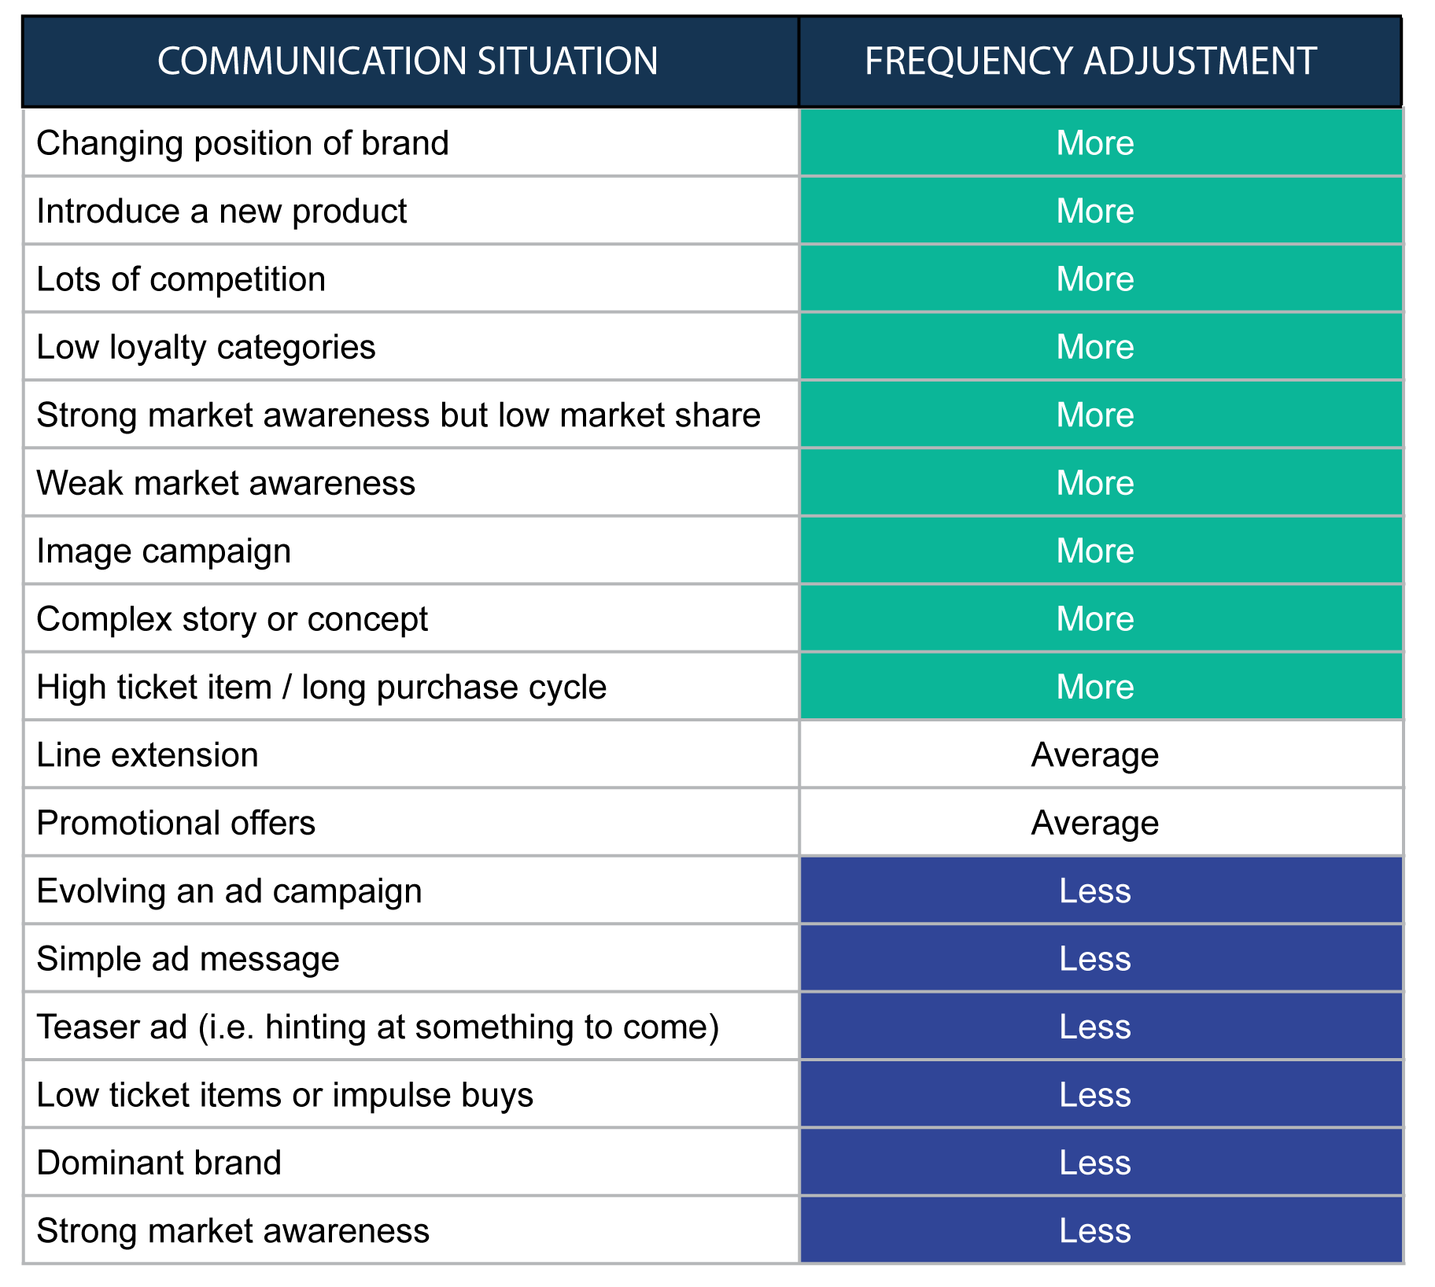
Communication Situations

Slide 13
Frequency Works in Newspapers

