Slide 1

Community Newspapers
Drive Results
2016
www.newspaperscanada.ca

Slide 2

Study Details
Study Timing
February 2016
Online Panel
UThink
2,408 Canadians surveyed
786 printed community newspaper readers;
467 buyers of new vehicles in past 2 years
National Scope
78% English / 22% French
Study Management
Totum Research
Nationally Representative Sample
Men 50%, Women 50%
18-34: 29%, 35-54: 37%, 55-64: 16%, 65+ 18%
West 31%, Ontario 39%, Quebec 23%, Atlantic 7%
Margin of Error
±2.0% at the 95% confidence level
This project was produced with the financial support of the Government of Canada through the Canada Periodical Fund of the Department of Canadian Heritage. The content of this study represents the opinions of the authors and does not necessarily represent the policies or the views of the Department of Canadian Heritage or the Government of Canada.

Slide 3
Community Newspapers Drive Results
Study Objectives
Measure newspaper readership by platform, device and community size.
Measure engagement with printed community newspapers in Canadian households.
  Time spent with newspaper
  Follow different types of news
  Reasons for reading printed newspapers
  Source of information about local community
  Understand the role of printed community newspapers in the automotive path-to-purchase.

Slide 4

Community Newspapers Drive Results
Eight in ten Canadians read newspapers across all platforms.
Printed community newspapers are dominant in smaller communities.
Community newspaper engagement is strong.
  Time spent with the printed paper unchanged
  Local information main reason for reading
  Favourite source for local news and information
Community Newspapers Drive Results, Totum Research, February 2016

Slide 5




Eight in Ten Canadians
Read Newspapers Across Platforms
83% of adults* read newspaper content across multiple platforms.
Canadians still prefer their newspaper content in printed format.
Community Newspapers Drive Results, Totum Research, February 2016
* Base: Communities with populations less than 100,000

Slide 6


Media Engagement is Important
The primary goal of advertising is
to reach a defined audience to
affect behaviour and influence
potential consumers.
Engagement:
Shows readers are paying attention.
Demonstrates a level of connection.
Sets the stage for influence to occur.
Necessary for community to form.

Slide 7

Printed Community Newspaper Engagement
Time spent with a printed community newspaper is virtually unchanged compared with two years ago.
Readers tend to follow news closely with local news being the most attentively sought.
The predominant reason for reading a community newspaper is local news.
The printed community newspaper is the favourite source of local news and information.
Source: Community Newspapers Drive Results, Totum Research, February 2016

Slide 8

Printed Community Newspaper Engagement
Time Spent Reading (vs. 2 years ago)
The time spent with a printed community newspaper is virtually unchanged compared with two years ago.
82% spend about the same amount of time or more with their printed community newspaper.
About the same
67%
More Time
15%
Less time
18%
Source: Community Newspapers Drive Results, Totum Research, February 2016; Base: Printed community newspaper readers

Slide 9
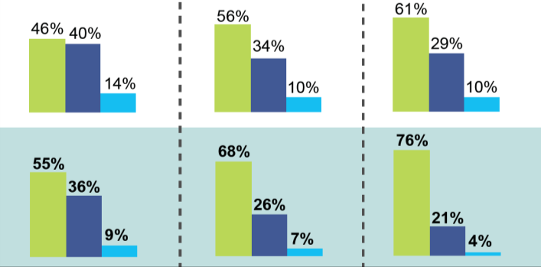
Follow Different Types of News
Most of the time
Only when something is happening
Seldom or never
International News
National News
Local News
All Adults
Community Newspaper Readers*
Printed community newspaper readers are more likely to closely
follow all three types of news most of the time.
Community Newspapers Drive Results, Totum Research, February 2016; * Printed community newspaper readers
Notes:
Most people follow news closely – the closer to home the better

Slide 10

Reasons for Reading Printed
Community Newspaper
Local Information
  Local Editorial, Sports, Entertainment, Events or News
Advertising
  Flyers/Inserts or Advertising in the paper
Classified Ads/Real Estate/ Employment
Readers in smaller population markets* demonstrate marked differences in reasons for reading their printed community newspaper.
Community Newspapers Drive Results, Totum Research, February 2016
* Base: Communities with populations less than 100,000

Slide 11
Printed Community Newspaper Engagement
Reasons for Reading Printed Community Newspaper
Population 100K+
Population <100K
95%
96%
64%
72%
43%
57%
Local
Information*
Advertising*
Classified/Employment/
Real Estate
Printed community newspaper readers are reading for
local information as well as advertising.
In markets with less than 100,000 population, 72% of printed community newspaper readers want advertising.
Community Newspapers Drive Results, Totum Research, February 2016
* Local Information=Local News, Editorial, Sports, Entertainment, Events; Advertising=Advertising in the paper, Flyers/Inserts
Notes:
Regardless of community size/population, LOCAL is still a key reason for reading community newspapers. 96% of readers in small community read for LOCAL information.

Slide 12
Printed Community Newspaper Engagement
Reasons for Reading Printed Community Newspaper
Population 100K+
Population <100K
Local news is the most popular reason for reading printed community newspapers.
Community Newspapers Drive Results, Totum Research, February 2016
Notes:
Regardless of community size/population, LOCAL is still a key reason for reading community newspapers. 96% of readers in small community read for LOCAL information.
Not much different when it comes to Local Editorial or Local Sports, but Local Entertainment (117), Events (113) and News (119) are overwhelming reasons the smaller the community size.

Slide 13
Printed Community Newspaper Engagement
Reasons for Reading Printed Community Newspaper
Population 100K+
Population <100K
Two thirds (67%) of readers in smaller communities want the flyers/inserts in their printed community newspapers.
Community Newspapers Drive Results, Totum Research, February 2016
Notes:
Surprisingly almost three quarters of smaller population readers chose Flyers/Inserts or ROP Advertising as their reasons for reading.
But, not surprising that two thirds of readers in smaller communities choose Flyers and Inserts as their reason for reading. The printed flyer habit is well entrenched with community newspaper readers.

Slide 14


Printed Community Newspaper Engagement
Local Information Sources
    Top Three Media for Local Information
              Printed community newspapers
              Local television news broadcast
              Local radio broadcast
In smaller markets* both printed community newspapers and
“word of mouth” usage increase more than 30%.
Community Newspapers Drive Results, Totum Research, February 2016;
* Base: Communities with populations less than 100,000

Slide 15
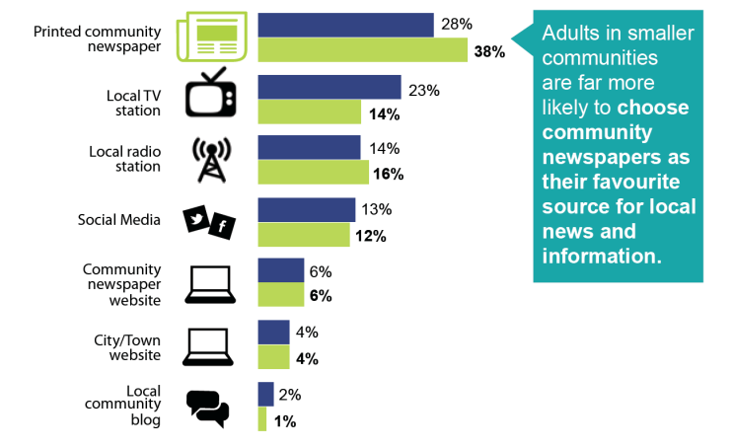


Favourite Source of Local News and Information
Population 100K+
Population <100K
Community Newspapers Drive Results, Totum Research, February 2016

Slide 16
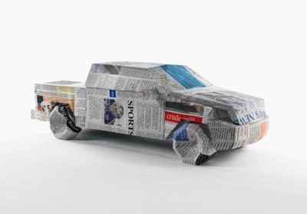
Community Newspapers Drive Results for Vehicle Sales
Printed community newspaper readers notice vehicle advertising in their papers.
                Newspapers and their websites:
                Are the most influential media at all 3 stages of the automotive purchase cycle;
                Trigger visits to automotive websites (manufacturer, brand/model, dealer); and
                Generate dealership visits and test drives.

Slide 17

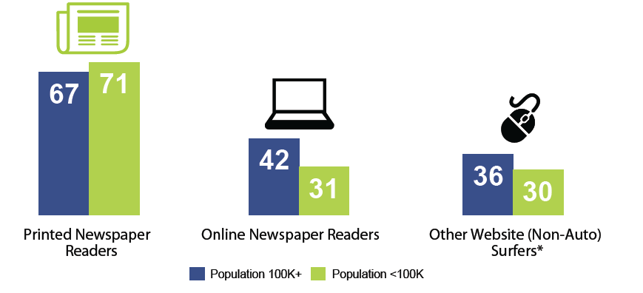
Vehicle Ads in Newspapers are Read
Community Newspapers Drive Results, Totum Research, February 2016; Base: Printed community newspaper readers
* Websites excluding newspaper, TV, radio, magazine, auto media sales and vehicle manufacturer, model and retailer sites
Notes:
Printed Newspaper - <100K population (100K+ population)
92% (83%) of printed community newspaper readers said their newspaper carries auto ads.
Of these, 77% (81%) said they read or look at the auto ads for a net exposure of 71% (67%) of new car buyers.
Newspaper Website - <100K population (100K+ population)
57% (63%) of printed community newspaper website readers said the website carries auto ads.
55% (67%) read or look at these ads for a net exposure of 31% (42%)
Other (Non-Auto) Sites - <100K population (100K+ population)
42% (47%)of site browsers said they read or look at ads on the site.
71% (76%) said the specifically read or look at the auto ads for a net exposure of 30% (36%)

Slide 18
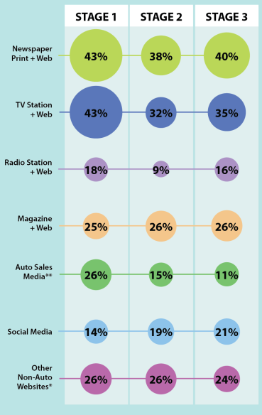
Media Influence in
Auto Path-to-Purchase
Newspapers and their websites are the most influential media in all 3 stages.
Stage 1 Thinking about buying or replacing vehicle
Newspapers and Television are both key media in this first stage.
Stage 2 Researching options
Newspapers are the top influence when consumers are conducting automotive research.
Stage 3 Ready to make purchase decision
40% of new car buyers/printed readers are influenced by newspapers and their sites when they are ready to make a purchase.
Community Newspapers Drive Results, Totum Research, February 2016
Base: Printed community newspaper readers that purchased a new car in the past 2 years
*Websites excluding Newspaper and Auto Manufacturer, Model and Retailer sites **Autotrader, Kijiji etc.

Slide 19
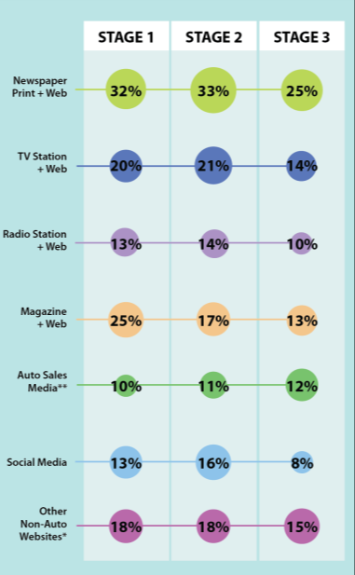
Media That Trigger Automotive Website Visits
Manufacturer
Site
Brand/Model
Site
Dealer
Site
Newspapers and their sites are effective at driving traffic to automotive sites.
Manufacturer Website
Newspapers, Magazines and Television are the top 3 media that drive traffic to manufacturer websites.
Brand/Model Website
33% of new car buyers/printed readers visit a Brand/Model website based on exposure to newspapers in print or digital.
Dealer Website
Newspapers are the most effective choice to generate visits to dealer websites.
Community Newspapers Drive Results, Totum Research, February 2016
Base: Printed community newspaper readers that purchased a new car in the past 2 years
*Websites excluding Newspaper and Auto Manufacturer, Model and Retailer sites **Autotrader, Kijiji etc.

Slide 20
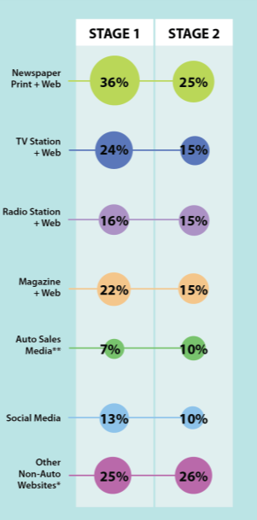
Media That Trigger
Car Dealership Visits and Test Drives
Dealer Visit
Test
Drive
Newspapers and their websites are the most influential media.
Dealership Visits
Newspapers and their sites (36%) are key drivers for dealership visits.
Booking Test Drives
Newspapers and other non-auto websites are the top motivators for booking test drives.
Community Newspapers Drive Results, Totum Research, February 2016
Base: Printed community newspaper readers that purchased a new car in the past 2 years
*Websites excluding Newspaper and Auto Manufacturer, Model and Retailer sites **Autotrader, Kijiji etc.

Slide 21
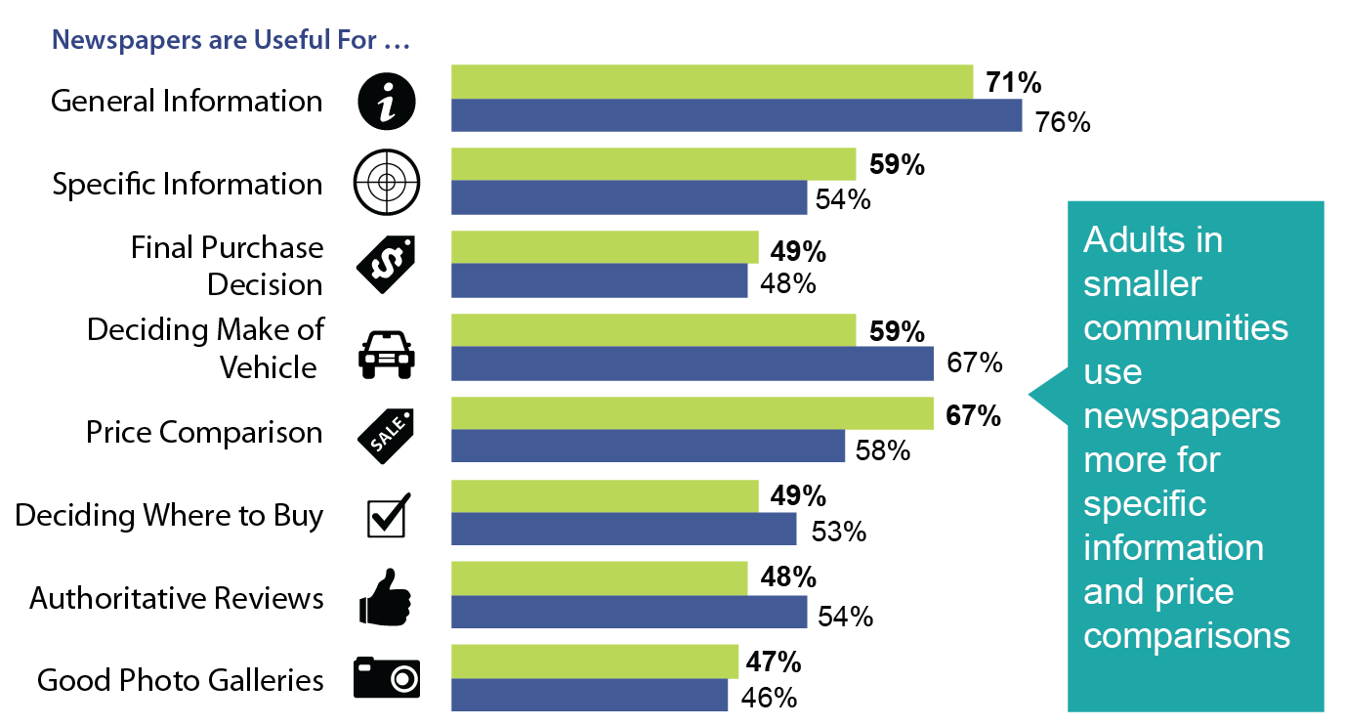
Newspapers Influence Auto Purchase Decisions
Population 100K+
Population <100K
Community Newspapers Drive Results, Totum Research, February 2016

Slide 22
Community Newspapers Drive Results
Newspapers and their sites influence the Auto path-to-purchase.
They are the most influential media at all 3 stages of the auto purchase cycle;
They trigger visits to auto websites (manufacturer, brand/model, dealer); and
Newspapers generate dealership visits and test drives.
Printed newspapers influence purchase decisions.
Adults in smaller communities use newspapers more for specific information and price comparisons.
Community Newspapers Drive Results, Totum Research, February 2016

Slide 23
Community Newspapers
Drive Results
2016
www.newspaperscanada.ca

