Slide 1

Community Newspapers Drive Results
5 Things You Thought You Knew About Community Newspapers
Notes:
Today I want to share the results from one of the research studies we recently released. But first I want to acknowledge the generous support of the Department of Canadian Heritage and the Canada Periodical Fund.
Anyone who knows me knows that I am all about the numbers. So today I am going to talk about five things you THOUGHT you knew about community newspapers.
Multi platform readers
Readers want Local Information AND Advertising
Readers NOTICE automotive advertising in their paper
Printed community newspapers are the favourite source of local information
Community newspapers are the original social media.

Slide 2




5.
42% of printed community newspaper readers are multi-platform readers. They access content across ALL platforms.
60%
50% Desktop/Laptop
41%
Newspaper
Smart-phone
46% Tablet
Community Newspapers Drive Results, Totum Research, February 2016
Notes:
Let’s start with #5. I bet you thought that community newspaper readers only read in print.
Printed Community Newspaper Readers are Multi Platform Readers.
In addition to the printed newspaper, community newspaper readers are also reading on their phone, on their desktop or laptop as well as on their tablet.
In fact, four out of ten (42%) read newspaper content on ALL FOUR platforms.

Slide 3
4.
Printed community newspaper readers are reading for local info and advertising.
All Printed Community Newspaper Readers
Population 100K+
Population <100K
95%
67%
48%
95%
96%
64%
72%
43%
57%
Local
Information*
Advertising*
Classified/Employment/
Real Estate
In markets with less than 100,000 population, 72% of printed community
newspaper readers want advertising.
Community Newspapers Drive Results, Totum Research, February 2016
* Local Information=Local News, Editorial, Sports, Entertainment, Events; Advertising=Advertising in the paper, Flyers/Inserts
Notes:
And now for #4. I bet you thought the only thing printed community readers wanted was local information.
In all sizes of markets across Canada more than 95% of readers want local information – and that would be local news, local events, local entertainment, local sports and local editorial.
But what you may not have know is that printed community newspaper readers also want advertising – and many different types of advertising
At least two thirds (67%) of readers in all market sizes want flyers, inserts and ROP advertising.
And in markets that are less than 100,000 population 57% still read for the Classified, Employment and Real Estate advertising.

Slide 4
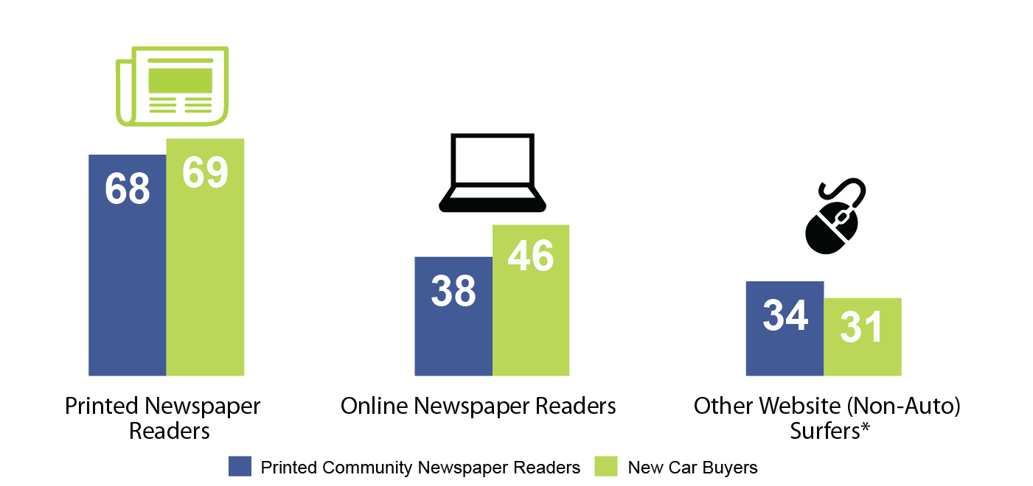

3.
Automotive ads in printed newspapers get noticed.
7 OF 10 PRINTED COMMUNITY NEWSPAPER READERS NOTICE THE VEHICLE ADS IN THEIR PRINTED PAPER.
Community Newspapers Drive Results, Totum Research, February 2016
* Websites excluding newspaper, TV, radio, magazine, auto media sales and vehicle manufacturer, model and retailer sites
Notes:
#3 – You were probably wondering if automotive ads get noticed – since it is one of the largest revenue categories.
You probably already knew that community newspaper readers were engaged, but did you know that seven out of ten new car buyers as well as readers actually NOTICE the vehicle ads?!
The Community Newspapers Drive Results study looked at community newspaper engagement as well as the role of the printed community newspaper in the automotive path to purchase.

Slide 5

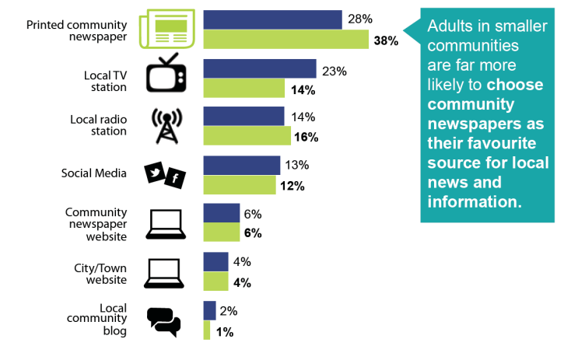
2.
Community newspapers are the favourite source of local information.
New Car Buyers
Adults 18+
42%
40%
New Car Buyers*
Adults 18+
Printed Community Newspaper
Four out of ten adults choose printed community newspapers as their favourite source for local news and information.
Community Newspapers Drive Results Totum Research February 2016; *in the past 2 years
Notes:
#2 - Maybe you thought that printed community newspapers were the favourite source of local information. If you did, then that one you were right about!
Four out of ten adults choose printed community newspapers as their favourite source of local news and information. That is almost double any of the other local media sources. And it is even slightly higher for new car buyers in the past 2 years.

Slide 6
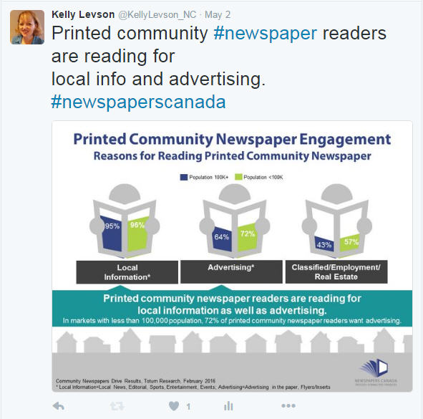



1.
Community #newspapers are the #originalsocialmedia.
#newspaperscanada
1752
2002
2004
2006
2010
Notes:
And now for #1 … something you probably knew but didn’t realize … community newspapers are the original social media.
From the beginning, community newspapers have been where your local community finds out what is happening to the people they care about … long before other social media.

Slide 7
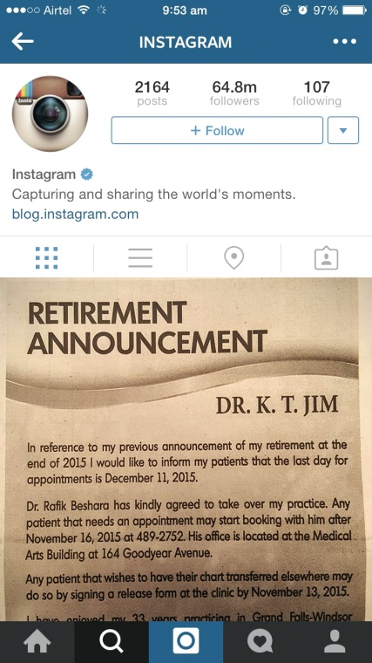
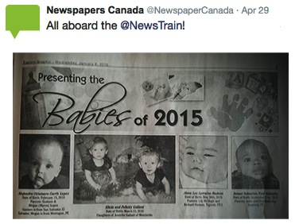
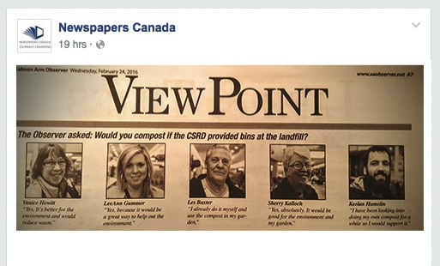
Community #newspapers are the #originalsocialmedia
#newspaperscanada
Notes:
The local community has always looked to find out about …
births and deaths, local opinions, who is retiring, what the local sports teams are doing, who is graduating …
all in their printed community newspaper.

Slide 8


Facebook has been oversold to advertisers.
Only 1.5% of retailers’ last click e-commerce transactions came from social media (Facebook).
Notes:
Today’s social media – Facebook, Instagram, Twitter, LinkedIn – should be used to amplify messaging instead of being used as a media channel.

Slide 9




Objective: Encourage SK consumers to download mobile app using a contest to win tickets to a live event show.
Just Blink Campaign
    Social Media
    Campaign
    Community Newspaper
    Campaign
Classified ad
2 insertions/2 weeks
$718 cost
97 downloads
$7.40 each
Facebook ad
6 days
$929 cost
21 downloads
$44.24 each
Notes:
And finally, lets take a look at advertising.
Here is an example of how Facebook advertising compares to the original social media – advertising in printed community newspapers.
If you want proof about the effectiveness of the true “social media” here is a recent campaign example that ran in both community newspapers (Classified section) as well as Facebook.
The objective was to drive downloads of the mobile app JustBlink. Based on total downloads and cost, community newspapers are the hands down winner with more app downloads and a much lower cost per download.
That is something that you probably thought you knew … and now you have a solid case to prove it.

Slide 10
Community Newspapers
5. Multi platform readers
4. Readers want local information + advertising
3. Readers NOTICE printed auto advertising
2. Favourite source of local information
1. Original social media
Notes:
So just to recap … community newspapers
Have multi platform readers
Have readers who want their local information as well as advertising
Have readers who actually notice the auto ads
Are chosen as the favourite source of information, and
Are the effective AND original social media

Slide 11
Community Newspapers Drive Results
5 Things You Thought You Knew About Community Newspapers
Financial support provided by the Government of Canada through the Canada Periodical Fund of the Department of Canadian Heritage.
Notes:
Thank you.

