Slide 1
LIVING & WORKING WITH CANADA’S ANTI-SPAM LEGISLATION
The Publisher’s Guide to CASL Compliance

Slide 2
The Publisher’s Guide to CASL Compliance
Agenda
Introductory Remarks
Andrew Nunes
Adrienne Rutherford
Vesna Moore
Derek Lackey
Q&A
Wine & Cheese Reception

Slide 3
The Publisher’s Guide to CASL Compliance
Sponsors

Slide 4
The Publisher’s Guide to CASL Compliance
Disclaimer
Our session and advice should not be considered legal advice. The information being presented is based on industry best practices and our interpretations of the laws and guidelines published

Slide 5
The Publisher’s Guide to CASL Compliance
The Big Picture
Andrew Nunes, Fasken Martineau

Slide 8
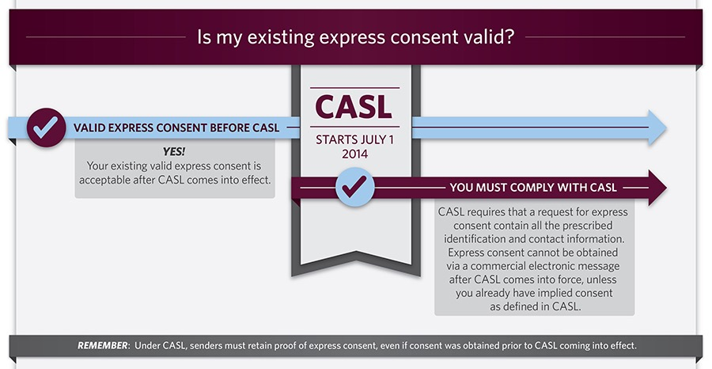

Slide 9
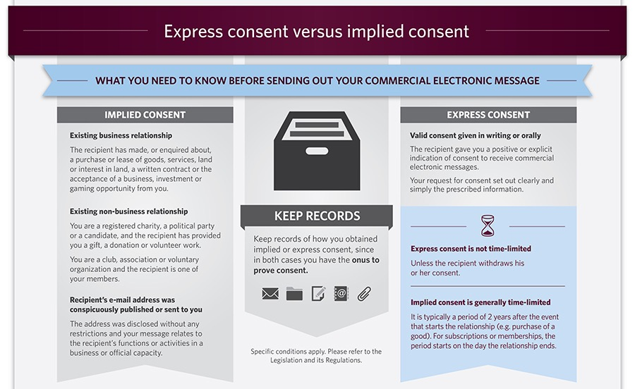

Slide 10
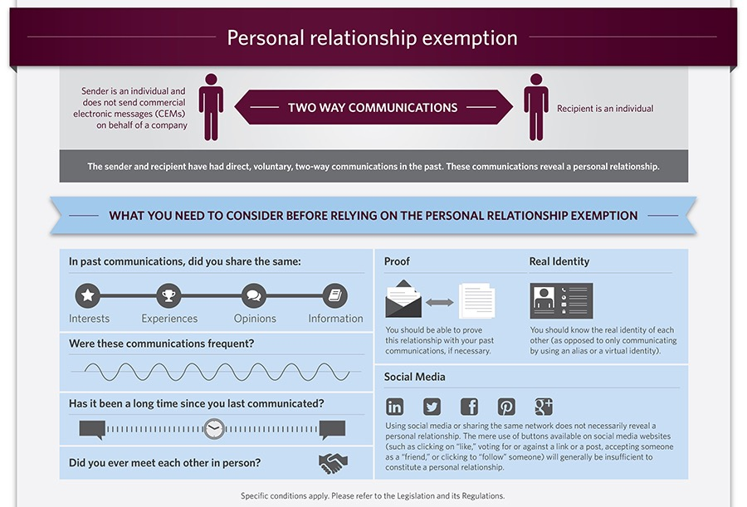

Slide 11
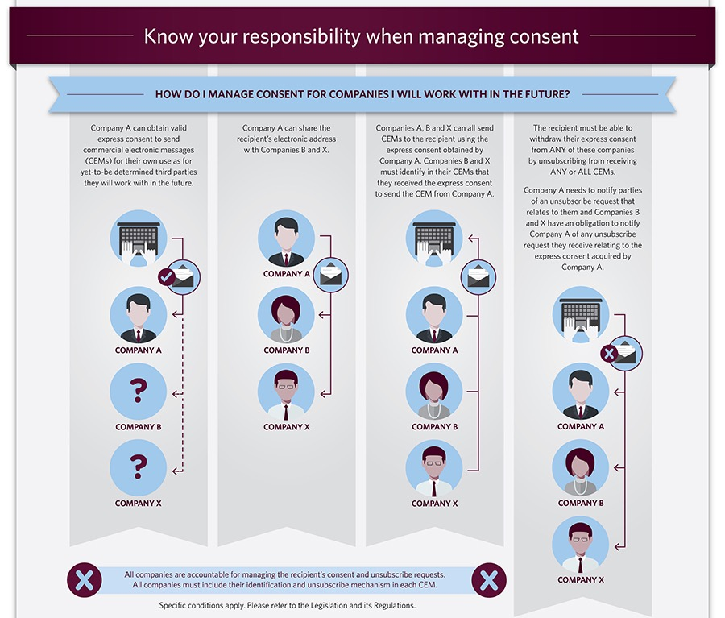

Slide 12
The Publisher’s Guide to CASL Compliance
The Publisher's Considerations
Managing Business Risk
Adrienne Rutherford, Media Lawyer

Slide 13
CASL - Publisher Risk and Mitigation
The Publisher’s Guide to CASL Compliance
Business Risk without insurance
(important for third party contracts)
What is the biggest Cost? It might surprise you.
How to Mitigate the Risk

Slide 14
What is the biggest cost?
The Publisher’s Guide to CASL Compliance
Fines?
Class Action?
Investigations?
Settlements?
Reputation?
Retrofit/Lost Assets?

Slide 15
Fines?
The Publisher’s Guide to CASL Compliance
CASL’s fines and responsibility of Directors designed to get attention and compliance
It wasn’t expected that “good players” who were trying but had made mistakes would be subject to fines but we have Porter, Rogers, Kellogg (all undertakings)
Recent relief from CRTC in Blackstone

Slide 16
Class Action?
The Publisher’s Guide to CASL Compliance
The potential for huge costs and protracted distraction of resources is why we are here today

Slide 17
Class Action?
The Publisher’s Guide to CASL Compliance
Risk probably higher for large organizations as it will be driven by class action lawyers who need a volume to justify the work
Consumer awareness and empowerment

Slide 18
Investigations?
The Publisher’s Guide to CASL Compliance
Resources required to respond to an investigation are both internal and external
Time frames given to respond are very short so more pressure on resources
List assets may be further diminished under scrutiny of an investigation

Slide 19
Settlements?
The Publisher’s Guide to CASL Compliance
Currently being used to avoid class actions
Significant fines
Far higher level of compliance (eg. internal resources and documentation)
You have used your mulligan

Slide 20
Reputation?
The Publisher’s Guide to CASL Compliance
Consumers have rapidly adapted an entitlement to good practices
Failure at compliance may undermine credibility with consumers
Failure at compliance may undermine credibility with business partners

Slide 21
Retro-fit/Lost Assets?
The Publisher’s Guide to CASL Compliance
Cost of retro-fitting compliance - better to collect with compliance in mind (Privacy by Design)
List assets with mixed compliance may have to be destroyed

Slide 22
Mitigation
The Publisher’s Guide to CASL Compliance
Internal testing
B2B verus B2C
Strict Controls/Gatekeepers
Third Parties
No Insurance
Cost-Benefit Analysis
Avoid Complaints
Have proof

Slide 23
Uninsurable Risk
The Publisher’s Guide to CASL Compliance
CASL excluded from policies
Coverage not likely to be available until scope of exposure more clear
Related risks may be covered under cyber insurance policy
Business interruption likely not covered

Slide 24
Cost-Benefit Analysis
The Publisher’s Guide to CASL Compliance
Upside versus risk of CEM
Does the revenue/engagement goal justify the risk
Unsubscribe all
Oversight of all lists because deployment by one department can diminish the list asset

Slide 25
Avoid Complaints
The Publisher’s Guide to CASL Compliance
What is the content of the “offer”? will it annoy people or confuse them as to where it came from causing them to complain?
How quickly and easily can one unsubscribe?
Would it help to remind them when they gave consent?

Slide 26
Proof
The Publisher’s Guide to CASL Compliance
Onus is on you to provide evidence of consent
How do you measure “business relationship” for implied consent and is it kept current
Best practices would allow access to consent status through a customer preference centre

Slide 27
Internal Testing
The Publisher’s Guide to CASL Compliance
Someone should receive every email deployed to ensure volume isn’t an issue or less worthy use weakens list asset
Make sure your unsubscribe works EVERYDAY
Make sure unsubscribes are effective asap but no more than 10 days and 2 clicks
Don’t wait for customer complaints as your quality control

Slide 28
B2B versus B2C
The Publisher’s Guide to CASL Compliance
Different requirements so be careful to keep the lists separate
Ensure B2B is relevant to the recipients business

Slide 29
Strict Controls
The Publisher’s Guide to CASL Compliance
Part of overall Privacy Policy and Practices
Process
Gatekeeper
Escalation policy
Incident Response

Slide 30
Third Parties
The Publisher’s Guide to CASL Compliance
Contracting out - vendors used for fulfillment
Contracting In - use of third party lists
Marketing Services - sending CEM’s on behalf of third parties
US Vendors and Customers - may offer more attractive rates but may have limited awareness of unique Canadian laws
Keep lists clean - do not mingle with third parties
Control deployment - don’t release lists or have them return/delete

Slide 31
Contracts
The Publisher’s Guide to CASL Compliance
Allocation of risk - do you need an indemnity? can you provide an indemnity?
Include specific CASL obligations of each party
Allocate remediation obligations of each party
Include requirement to sign off on campaigns
Ensure each party has industry standard obligations regarding security and compliance with PIPEDA

Slide 32
The Publisher’s Guide to CASL Compliance
What We Did & How
Vesna Moore
Annex Business Media
Director of Circulation and CASL Compliance Officer

Slide 33
The Publisher’s Guide to CASL Compliance
Go Back…
…Way Back to Jan 2014

Slide 34
The Publisher’s Guide to CASL Compliance
CASL
PIPEDA
Penalties - Applies to corporations and individuals
$10,000,000 per violation for a company
$1,000,000 per violation for an individual
Charges Levied to Date:
March 5, 2015 | Compufinder | $1.1 Million
March 25, 2015 | Plentyoffish Media Inc | $48,000
June 29, 2015 | Porter Airlines | $150,000
November 20, 2015 | Rogers Media | $200,000
March 11, 2016 | Avis Budget Group Inc | $30 Million Competition Bureau via CASL
November 2, 2016 | Blackstone Learning Corp | $640,000 to $50,000
July 1, 2014 CASL in Effect
Jan. 15, 2015 CASL Computer Program Provisions in Effect
July 1, 2017 CASL Private Rights of Action Takes Effect

Slide 35
The Publisher’s Guide to CASL Compliance
The Basic Questions
Who Will Champion this?
Who Will Be Responsible For Compliance?
What Departments/Individuals Need to be Involved?
Where Do We Start?
Do We Need Legal Counsel?
We did get legal counsel, printed out the legislation, read it, read it again, debated it, attended many seminars, read it again, debated it, etc, etc.

Slide 36
The Publisher’s Guide to CASL Compliance
Beginning Implementation
Inventory of our outgoing emails and types of communications we send
Determine existing consent and how it relates to CASL requirements
Assess all sources of email acquisition and our ability to track and provide proof
Determine the levels of Risk our organization is willing to accept
Create a CASL Implementation Plan
Produce CASL Requirement Specs for Implementation

Slide 37
The Publisher’s Guide to CASL Compliance
Samples for
Implementation
The Plan

Slide 38
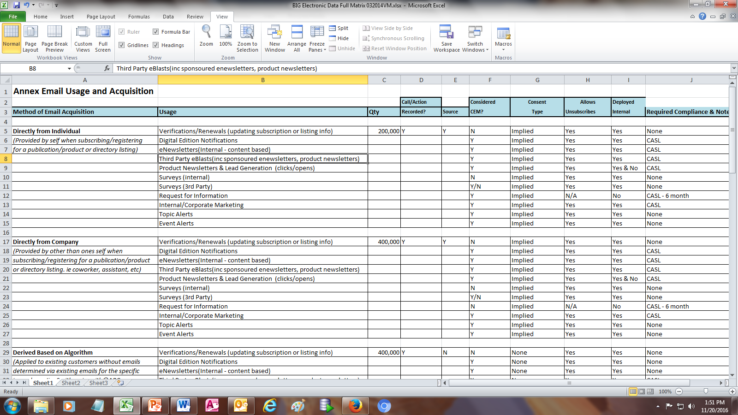
The Publisher’s Guide to CASL Compliance
Samples for
Implementation
The Inventory Matrix

Slide 39
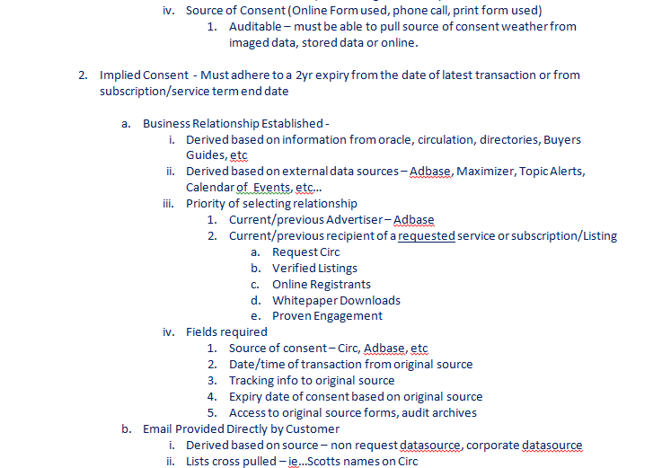
The Publisher’s Guide to CASL Compliance
Samples for
Implementation
The Specs

Slide 40
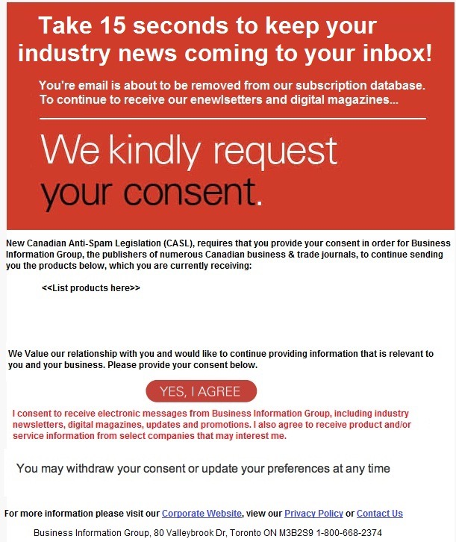
The Publisher’s Guide to CASL Compliance
Express Consent
Used Every Opportunity to Acquire Consent
Renewed Consent
On Subscription Forms Online and Paper, even in telemarketing
Used Pre-CASL Timeline to Get Consent
Sent Express and Implied Consent Requests to ‘No Consent’ emails
Used renewal requests for email newsletter and news alert emails to keep Implied Consent for 2 more years

Slide 41
The Publisher’s Guide to CASL Compliance
By July 2014
Go Live Ready
We fully implemented CASL into our systems and staff
Applied ongoing internal auditing of email usage
Restricted email access and deployment
Provided documentation and training to staff

Slide 42
The Publisher’s Guide to CASL Compliance
After July 2014
Better Unsub Management
Created a New Preference Centre
eNewsletter Sample

Slide 43
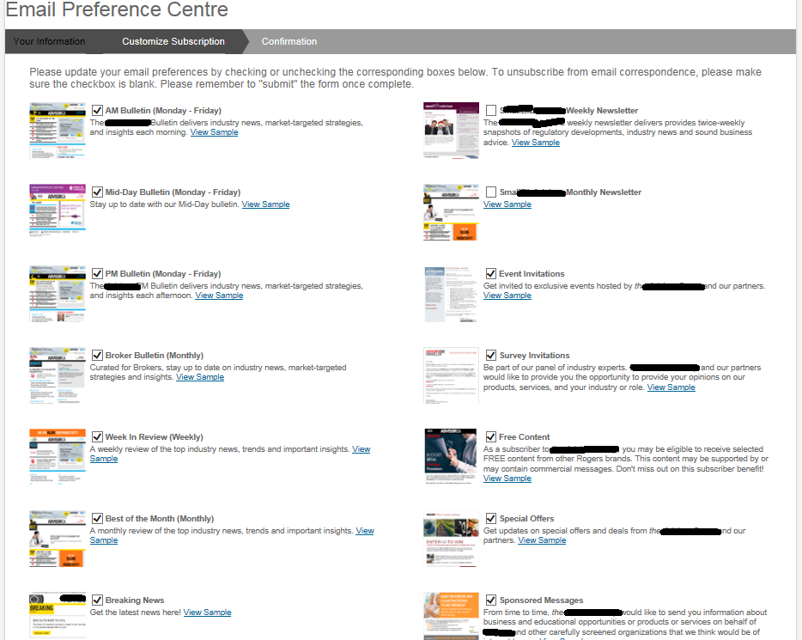
The Publisher’s Guide to CASL Compliance

Slide 44
The Publisher’s Guide to CASL Compliance
After July 2014
Make Our Email List Credible
Became First to Have a 3rd Party CASL Audit
&
Independent 3rd Party CASL Certification

Slide 45
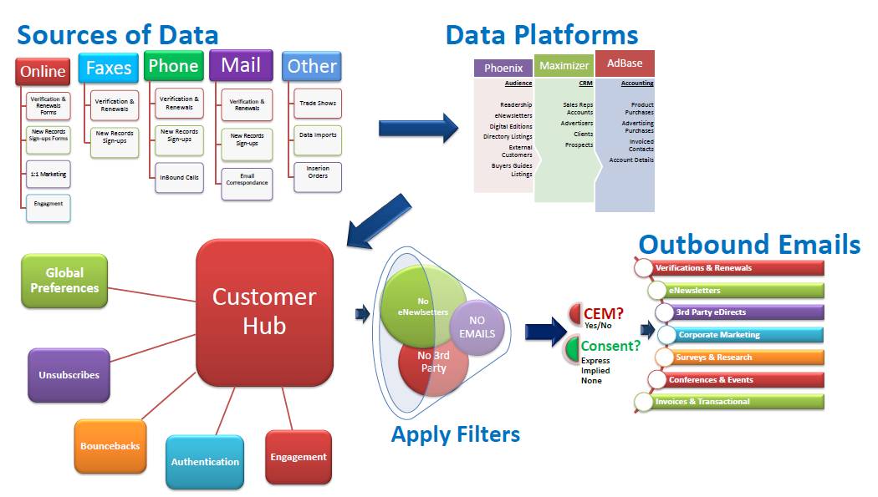
The Publisher’s Guide to CASL Compliance
Access Controls
Change Management
System Monitoring
Data & Process Flows
Physical Audit
Proof of Sources
Unsub Checks & Balances
Etc…

Slide 46
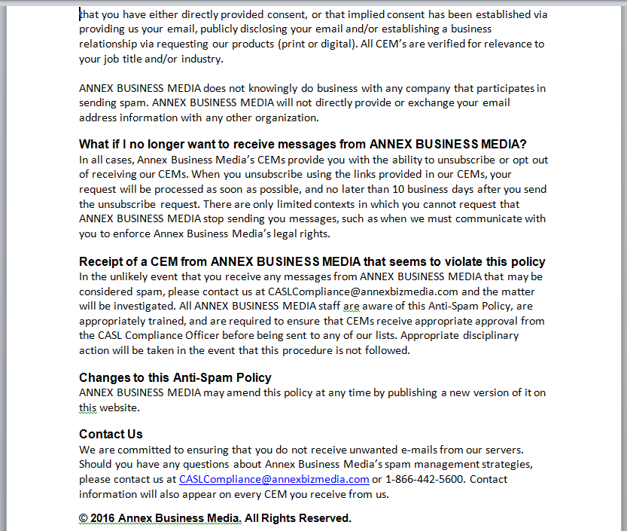
The Publisher’s Guide to CASL Compliance
Looking Towards
July 2017
We Continue to Change and Adapt
Constant Unsub Checks (with every deployment)
All Email Jobs Continue to Need Approval From Various Depts (content relevance, unsub checks etc)
Re-Assessment For Jul 2017
Ensuring Expires Are Honored But…We Are Working On Updating All We Can
2017 CASL Retention Plans and Budgets are Required
Future Info Sessions Planned For Staff in 2017
Outward Facing CASL Policy

Slide 47
The Publisher’s Guide to CASL Compliance
Looking Towards
July 2017
Similar to subscription marketing plans, set up marketing and conversion
campaigns for CASL Consent
Send Express Consent Conversion Emails to Implied Consent records
Search public domains to update expiring Implied Consent for 2 more years (B2B, print screens archived)
We are using telemarketing to acquire Express Consent (recorded and archived)
Working on asking for consent on enewsletter clicks

Slide 48
The Publisher’s Guide to CASL Compliance
5 Keys to
CASL Success

Slide 49
The Publisher’s Guide to CASL Compliance
Appoint CASL Professionals
Choose at least 1 or 2 individuals that will champion CASL requirements overall
Ensure these people are given the opportunity and authority needed to get the job done

Slide 50
The Publisher’s Guide to CASL Compliance
Get & Track
Consent
Use Every Opportunity to Acquire Consent
Ask for Express Consent where you can:
On Subscription Forms Online and Paper, even in telemarketing
Send Express Consent Requests while you still have consent
Use renewal requests of your email newsletter or news alert emails to keep Implied Consent for 2 more years

Slide 51
The Publisher’s Guide to CASL Compliance
Constant Audit & Documentation
No surprises please! Check and double check systems and processes on a regular, constant basis
Don’t wait to hear from readers about unsubs not working or emails being sent to the wrong list. Catch them before they’re a problem:
Implement an approval process – check content and links
Seed all appropriate internal emails on live sends – re-check links live
Regularly check recent unsubscribes are eliminated from send list
Generate CASL Policies and have a policy binder or directory
Keep all your CASL documentation
Log and track CASL complaints and CASL Issues as well as resolution

Slide 52
The Publisher’s Guide to CASL Compliance
Design Templates
Use a template on your outbound emails to minimize human error in creation
Templates, especially in header and footer sections can ensure:
Unsubscribe link is present on every email sent
All required disclosure information is on each email
Links to your website, privacy policy, CASL Policy, contact page

Slide 53
The Publisher’s Guide to CASL Compliance
Honour Readers Requests
Minimize all possible risk of irritated recipients. Honour their requests easily, quickly and consistently.
It’s simple – if they have no reason to complain, your customer
service people and your company benefit

Slide 54
The Publisher’s Guide to CASL Compliance
The 5 Stages of CASL Compliance
A Comprehensive Compliance Process

Slide 55
The Publisher’s Guide to CASL Compliance
Start with a comprehensive examination of your organization’s existing email marketing process.
How do you currently collect opt-ins?
What do you send? How often?
When do you send emails?
Does everyone get the same emails?
Do you have a CASL Compliance leader? Who is it?
Do you use a Email Service Provider (ESP)? Which one?
Do they manage unsubscribes and your preference page? Is it easy to execute?

Slide 56
The Publisher’s Guide to CASL Compliance
Using as many of your current email practices as possible, design your CASL compliant process.
Documenting your strategies - why does your organization use email?
Write your policies regarding implied and/or express consent.
Write CASL compliant language for all opt-in forms
With a clear understanding of all aspects of the legislation and the Government bodies who enforce it, design a process to suit your organization while satisfying the standards stated by CRTC, the Office of the Privacy Commissioner and the Competition Bureau.
This process must accomplish the goals and objectives of your email marketing program.

Slide 57
The Publisher’s Guide to CASL Compliance
Document your organization’s new email procedures and policies.
CRTC has made it clear that any ‘due diligence’ defence requires a comprehensive, documented process. They want to see your respect for individual’s privacy in writing.
They want to know CASL is taken seriously in your organization. That just adding another name and building a huge email list is no longer the primary objective of the marketing team.
They need to see that senior management is involved and is committed to respecting individual’s rights regarding electronic messaging.

Slide 58
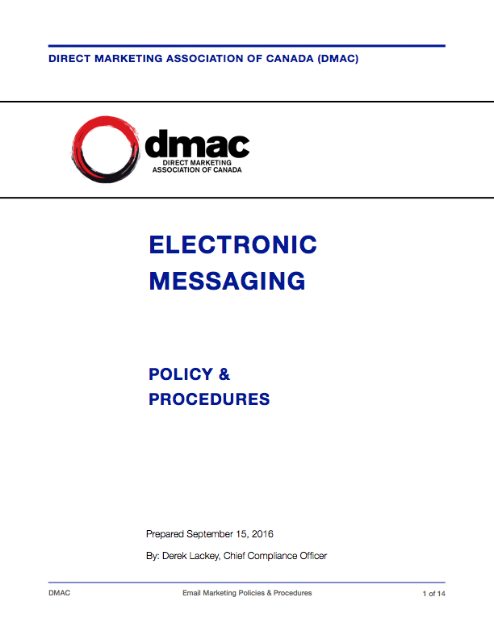
The Publisher’s Guide to CASL Compliance

Slide 59
The Publisher’s Guide to CASL Compliance
The burden of proof is on the organization. You must, at any given time, be able to prove your relationship with every individual on your email list.
The most difficult change ushered in by CASL is the ability to track real time data and the constant changes to your relationship with each individual on your list.
CASL Keep™ is using a platform that automates almost all of those changes.
We have a process to integrate your current systems into our technology.
The technology is designed to run in the background, tracking the data required to always prove CASL compliance. As changes happen in the real world, our technology is updated and your proof updates.

Slide 60
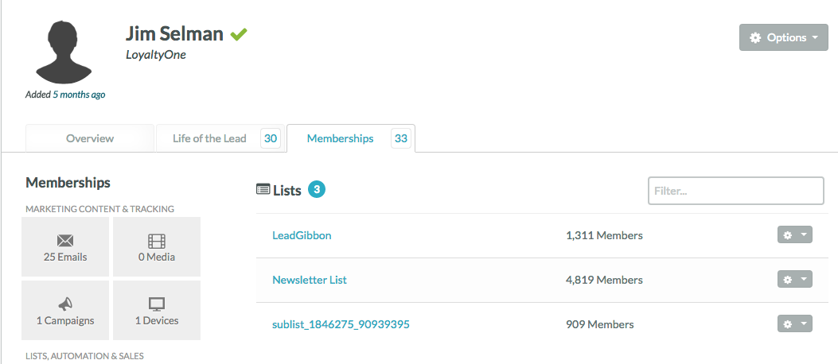
The Publisher’s Guide to CASL Compliance
First you must prove HOW & WHEN Jim Selman came to be on your email list.

Slide 61
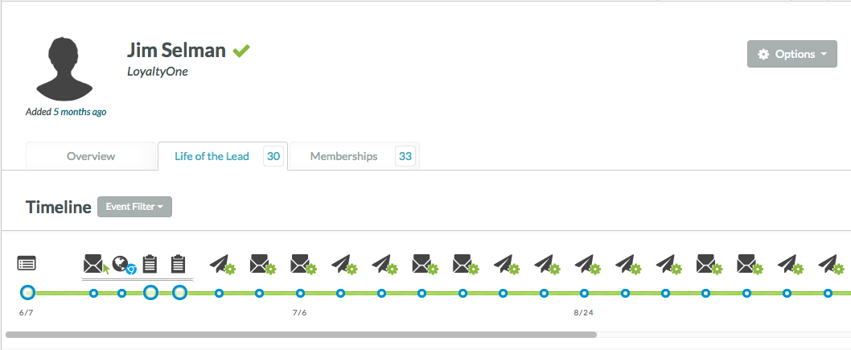
The Publisher’s Guide to CASL Compliance
Then you must always know your relationship with Jim in this fast paced changing world of digital communication

Slide 62
The Publisher’s Guide to CASL Compliance
CRTC expects every organization to integrate their CASL compliant process into their ongoing staff training.
Any staff member who touches email marketing in any manner, must be trained in the entire process.
We document the training and the dates. In the event of a CRTC audit, providing dates of training and who attended is important.
Management will agree on the timing (every 6 months or annually)

Slide 63
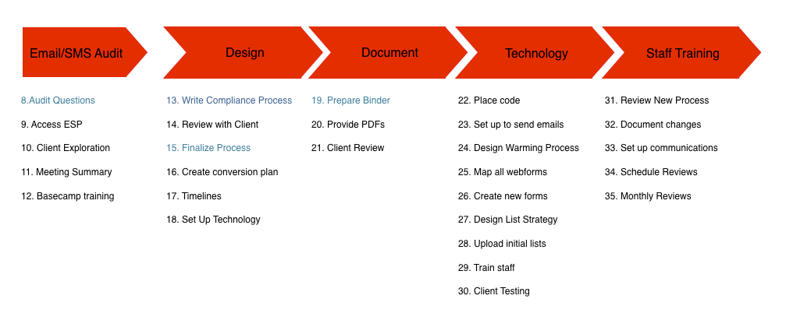
The Publisher’s Guide to CASL Compliance
Compliance Roadmap

Slide 64
The Publisher’s Guide to CASL Compliance
Q&A

Slide 65
Thank You
The Publisher’s Guide to CASL Compliance

