Slide 1
“Trust in the news media is still very strong in Canada.”
Notes:
Environics Communications CanTrust Index

Slide 2
Canadians Trust Traditional News Media
Newspapers remain a trusted advertising source globally
Canadians view advertising positively
Traditional media advertising trusted
Trust in the traditional news media still very strong in Canada
Cure for Fake Journalism = Great Journalism

Slide 3
Newspapers Remain A Trusted Advertising Format Globally
60%
Six in 10 global respondents say they completely or somewhat trust ads in newspapers.
Nielsen Global Trust in Advertising Survey, Q1 2015
Notes:
Source: Nielsen Global Trust in Advertising Survey, Q1 2015

Slide 4

Canadians View Advertising Positively
Canadians continue to have a favourable impression of advertising they see, hear or read.
Most derive at least slight value from advertising and very few report that advertising provides no value at all.
A majority continue to find advertising helpful with consumer decision-making.
Consumer Perspectives on Advertising 2016, Advertising Standards Canada; The Gandalf Group
Notes:
https://www.adstandards.com/en/ASCLibrary/2016ASCConsumerResearch.pdf
Consistent with previous research findings, Canadians continue to have a favourable impression of advertising and a majority find it helpful.
Conducted in early 2016 by The Gandalf Group with a representative sample of 1,564 Canadians, this research continues ASC’s probing into consumer perceptions about advertising. This year, in addition to general views on advertising and perceptions of truth and accuracy of advertising across media types, we looked at Canadians’ perspectives on certain advertising themes with a spotlight on perceptions around sexism in advertising.

Slide 5
Canadians Trust Traditional Media Advertising
Canadian consumers more comfortable with levels of truth and accuracy in traditional media versus digital media.
More Canadians report higher comfort levels with ads in newspapers.
Lower levels of comfort with truth and accuracy in ads in digital media.
Consumer Perspectives on Advertising 2016, Advertising Standards Canada; The Gandalf Group
Notes:
https://www.adstandards.com/en/ASCLibrary/2016ASCConsumerResearch.pdf
As in previous studies, comfort levels with truth and accuracy continue to be higher in ads in traditional versus digital media.

Slide 6
Canadians Trust Traditional Media Advertising
Consumer Perspectives on Advertising 2016, Advertising Standards Canada; The Gandalf Group
Notes:
https://www.adstandards.com/en/ASCLibrary/2016ASCConsumerResearch.pdf
Consistent with previous research findings, Canadians continue to have a favourable impression of advertising and a majority find it helpful. As in previous studies, comfort levels with truth and accuracy continue to be higher in ads in traditional versus digital media.

Slide 7

Newspaper Ads are Most Trusted
Ads in Physical or Digital Format
49%
44%
40%
39%
Newspaper
Television
Radio
Magazine
Community Newspapers Drive Results 2017, Totum Research
*trust advertising content – top 2 responses Completely/Somewhat
Notes:
This analysis is also based on the full sample of 2403 respondents instead of just community newspaper readers to avoid bias.
Trust is a hot topic in 2017. Newspapers (in print and digital formats) top the list for trusted advertising content. The top four are shown here and they are the traditional media including their digital properties.
Digging a little deeper the data shows that
Millennials are more trusting of media in general – typically 15-30% more than the average adult 18+.
Boomers on the other hand are less trusting of advertising content (about 10% less than the average adults).
Influencers are the most trusting of all media – 40% more than average for traditional media and 70% more than average for digital media.

Slide 8


Printed/Digital Newspaper Ads Most Trusted
%
Community Newspapers Drive Results 2017, Totum Research
*trust advertising content – top 2 responses Completely/Somewhat
Notes:
This slide details all the media, broken out by their traditional and digital platforms. And again, Newspapers top the Trust list in both printed and digital formats.
Google - included under Search Engine (28%) and Facebook in Social Media (23%).
Social Media has seen one of the largest declines in trust over 2016 according to the 2017 CanTrust Index. “Significantly fewer respondents say that their Facebook news feed is their preferred information source (19% in 2017 versus 31% in 2016), with similar trends for Twitter and LinkedIn (both at 6% in 2017 from 10% in 2016).” CanTrust Index 2017
And research among Americans echoes this – BuzzFeed and Ipsos Public Affairs survyed 3,000 Americans and found that “Over half of those who took the survey said they trust the news they read on Facebook “only a little” or “not at all.”
http://www.niemanlab.org/2017/04/fake-news-is-affecting-peoples-trust-in-the-news-they-read-on-facebook/
Trust in news media organizations remains the second most trusted, after not-for-profit organizations. Product and service sampling or word-of-mouth are the most trusted sources of information about a product, service, brand or organization, followed by traditional editorial content. CanTrust Index 2017
http://environicspr.com/wp-content/uploads/2017/04/ECI_CanTrust_Report_2017.pdf

Slide 9


Trust In The News Media Is Still Very Strong In Canada
More than half of Canadians (54%) trust news media, second only to not-for-profit organizations (59%).
Seven out of ten Canadians (69%) felt that a strong presence in local communities contributes to increased trust.
Environics CanTrust Index, 2016
Notes:
http://www.marketingmag.ca/consumer/environics-research-uncovers-widespread-trust-deficit-173882?utm_source=EmailMarketing&utm_medium=email&utm_campaign=AM_Daily
The study was the first in what aims to become an annual measurement of the trust the general public, newcomers and primary household shoppers in Canada have in a range of organizations, leaders and industries.
The study asked people to use a seven-point scale to rank their trust in businesses, products and services, and governments and their ability to “do what is right for Canada, Canadians and our society.” The online survey of 1,001 Canadians 18 years or older was conducted from Feb. 29 to March 7 and was nationally representative.
In terms of organizations, respondents gave their most trust to not-for-profit organizations (59%), followed closely by news media (54%), with small to medium-sized corporations trailing at 44% and large corporations scoring a dismal 29%.
“This is a good news story for traditional media,” MacLellan says. “Trust in the news media is still very strong in Canada.”
In addition, the study asked Canadians to choose between speed and accuracy in news, with almost 80% preferring accuracy, MacLellan says. “For the traditional media, this is almost a referendum on real journalism versus citizen journalism. It shows that Canadians want accurate information.”
The study also asked people what is it that contributes to trust and found a strong presence in local communities helps (69%). “Organizations that show they’re investing in the community, creating jobs in the community are the sort of things that build trust.” Trust in word-of-mouth or recommendations by someone you know was the most trusted source of information when it comes to a product, service, brand or organization, at 75% of Canadians.

Slide 10
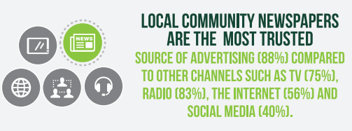
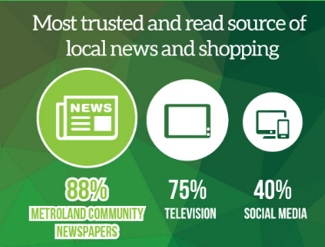
Metroland Media; Brandspark 2016

Slide 11
Trust in News:
Traditional Media Valued
%
Source: Earnscliffe Strategy Group; Online survey of 1,500 adult Canadians between September 22 and October 2, 2016

Slide 12
Canadians Trust Traditional News Media
Complex trust gap among Canadians in their attitudes toward traditional-style media organizations and social media.
Seven out of 10 respondents completely or mostly trust their news from newspapers, radio and television -- the figure drops to 15 percent for news acquired via social media.
Source: Earnscliffe Strategy Group; Online survey of 1,500 adult Canadians between September 22 and October 2, 2016

Slide 13
When asked to choose between speed and accuracy in news, almost 80% of Canadians prefer accuracy.
“For the traditional media, this is almost a referendum on real journalism versus citizen journalism. It shows that Canadians want accurate information.”
Bruce MacLellan, CEO, Environics
Environics Communications CanTrust Index
Environics CanTrust Index, 2016
Notes:
http://www.marketingmag.ca/consumer/environics-research-uncovers-widespread-trust-deficit-173882?utm_source=EmailMarketing&utm_medium=email&utm_campaign=AM_Daily
54% of Canadians trust news media …

Slide 14
“We found low levels of trust in social media companies (26%) and it has to be connected to privacy and how data is used is a big issue.”
“Social platforms know everything you do. Even with user rates at three quarters of the adult population, these companies should not equate popularity with trust.”
Environics Communications CanTrust Index
Environics CanTrust Index, 2016
Notes:
http://www.cantechletter.com/2016/04/canadians-trust-social-media-little-trust-oil-pipelines-says-survey/

Slide 15
“People will ultimately gravitate toward sources of information that are truly reliable, and have an allegiance to telling the truth.
People will pay for that because they’ll realize they’ll need to have that in our society.”
Martin Baron, Executive Editor
Washington Post

Slide 16
Cure for Fake Journalism =
Great Journalism
Post 2016 election, New York Times reports growth in digital advertising (+21%) and increase in digital subscribers (4 times the normal rate) – total digital/print circulation 3+ million
The Guardian US set a record for highest member sign-ups on a single day (November 9) at 25 times higher than normal.
Subscriptions up 160% at The Atlantic, and visitors to the magazine’s Web site who purchased a subscription have doubled.
Donations to political magazine Mother Jones up 10 times from an average day.
ProPublica (independent, non-profit newsroom) donations were 10 times the usual number post-election.
Notes:
http://www.nytimes.com/2016/11/07/business/media/medias-next-challenge-overcoming-the-threat-of-fake-news.html?_r=0
http://www.inma.org/blogs/Editors-Inbox/post.cfm/pro-media-backlash-to-trump-s-election-what-should-u-s-newspapers-do
http://www.niemanlab.org/2017/01/newsonomics-trump-may-be-the-news-industrys-greatest-opportunity-to-build-a-sustainable-model/?utm_source=API+Need+to+Know+newsletter&utm_campaign=d61544d6f2-EMAIL_CAMPAIGN_2017_01_23&utm_medium=email&utm_term=0_e3bf78af04-d61544d6f2-45829001
NY Times subscriptions up by 200,000+ (many not solicited)
Washington Post – double digit percentage increase in new subscriptions
Increased public support for The Atlantic, ProPublica, The Guardian, NPR, The New Yorker, Mother Jones, Vanity Fair, and the Los Angeles Times
http://www.poynter.org/2017/trump-bump-subscription-surge-brightens-otherwise-grey-results-at-new-york-times/447078/
- NY Times record 276,000 net quarterly growth in digital subscriptions in the last quarter of 2016

Slide 17
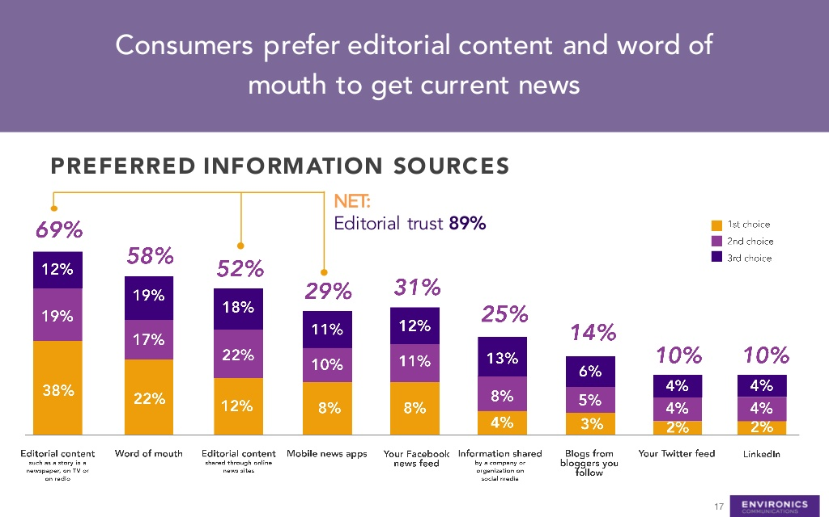
Nine in Ten Canadians Trust Editorial
Notes:
http://www.multivu.com/players/English/7819751-environics-cantrust-index/
Source: Environics Communications CanTrust Index 2016
The Environics Communications CanTrust Index is a study of the levels of trust Canadians have in organizations, leaders and industry segments. It focuses on the general public, newcomers and primary household shoppers and was conducted to help companies reduce their corporate trust deficit.

Slide 18
“Trust in the news media is still very strong in Canada.”
Notes:
Environics Communications CanTrust Index

