Slide 1
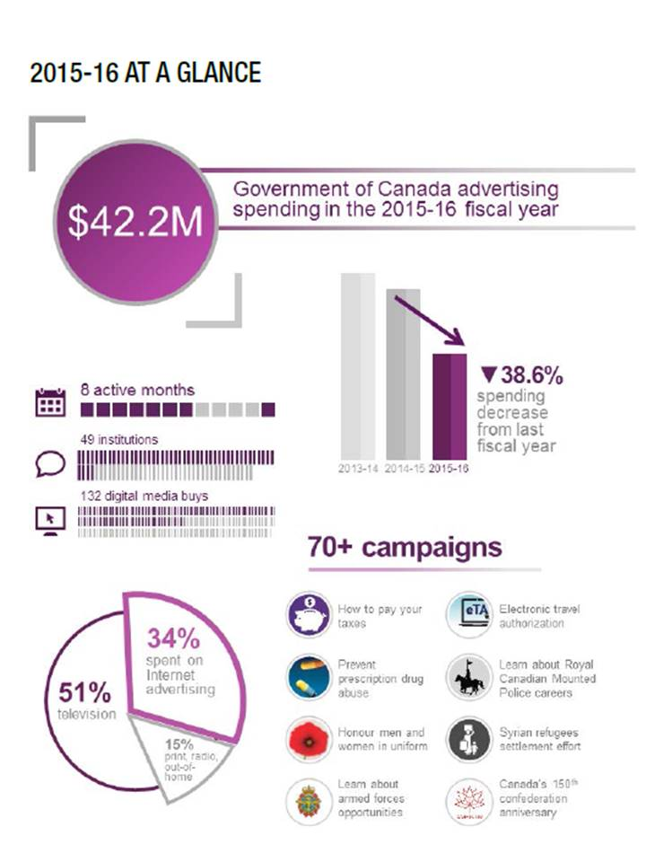
Government of Canada Advertising Activities 2015/2016

Slide 2
The Government of Canada has a duty to inform Canadians about its programs, services, policies and decisions.
Advertising is one of many ways the Government ensures that individuals, families and businesses have the information they need to exercise their rights and responsibilities and to make decisions about their health, safety and security.

Slide 3
Federal Government Advertising in Canada
Government spending on all media down 39% from previous year.
Government advertising expenditures by media type are not in line with where Canadians want to see ads.
Digital government advertising is on the rise, despite issues with trust and internet access in non-urban Canada.

Slide 4
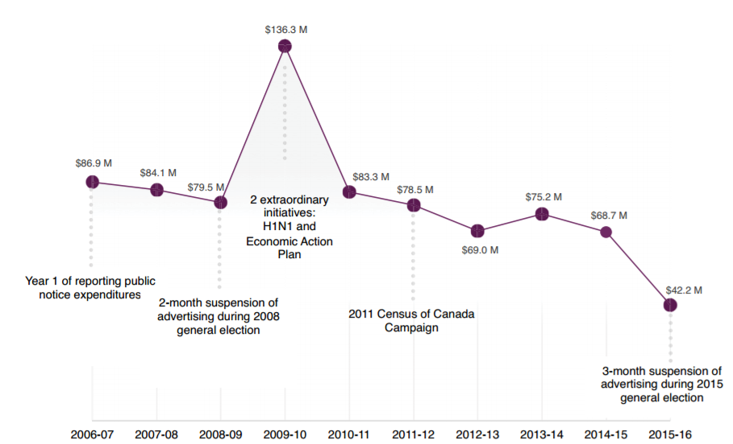
2015/2016 Advertising Expenditures
In fiscal year 2015-16, the Government of Canada spent $42.2 million on advertising – a reduction of $26.5 million from the previous year and the lowest amount since 2005-06, when under similar circumstances, advertising was suspended for several months because of a general election.
Source: Annual Report on Government of Canada Advertising Activities - 2015-2016
http://www.tpsgc-pwgsc.gc.ca/pub-adv/rapports-reports/documents/rapport-report-2015-2016-eng.pdf

Slide 5
2015/2016 Media Spending by Type
More than half (51%) of all media spending was on Television.
Just over a third (34%) of spending was on the Internet. The majority of this was in Display advertising (75%) including real-time bidding, a form of programmatic advertising. Social Media spending accounted for almost 11% and Search Engine Marketing represented another 14%.
Radio accounted for about 5% of all spending.
Newspapers (daily, weekly and official language/ethnic/aboriginal) account for just under 6% of all spending.
The balance of spending is split between Magazines (1.5%), Cinema (2%) and Out of Home (0.8%).
Source: Government of Canada Agency of Record, Cossette Media of Toronto,
a division of Cossette Communication Group.
Excludes media purchased directly by institutions for public notices.
NOTE: Weekly/Community Newspaper spending of $1,164,567 includes $676,004 for Official Language, Ethnic, Aboriginal publications – see APPENDIX.

Slide 6
Canadians Want Government Advertising in Newspapers
%
Almost three quarters (72%) of Canadian adults want to see advertising for government programs and services in newspapers.
In smaller markets (less than 100,000 population) six in ten adults believe community newspapers are the most appropriate media for government ads.
Source: Totum Research, December 2016; Base: 2,403 Canadian adults 18+
*Traditional + Digital formats
Q: Which of the listed media do you think are the most appropriate for advertising about federal, provincial and municipal/regional government programs and services?

Slide 7
Government Ad Spending Does Not Reflect Canadian Views on Most Appropriate Media
Spending on TV is over represented compared to all other media. Spending on Newspapers is under represented based on where Canadians want to see government ads.
Source: Totum Research, December 2016; Base: 2,403 Canadian adults 18+; *Traditional + Digital formats
Annual Report on Government of Canada Advertising Activities - 2015-2016
Q: Which of the listed media do you think are the most appropriate for advertising about federal, provincial and municipal/regional government programs and services?

Slide 8
Digital Advertising
Over the past several years, the Government of Canada has steadily increased its use of digital media as more and more Canadians spend time on digital and mobile platforms.
Display (including real-time bidding, a type of programmatic advertising)
Social media (Facebook, Twitter, LinkedIn)
Search engine marketing (Google, Bing, Yahoo!)
Source: Annual Report on Government of Canada Advertising Activities - 2015-2016
http://www.tpsgc-pwgsc.gc.ca/pub-adv/rapports-reports/documents/rapport-report-2015-2016-eng.pdf

Slide 9
Newspaper Advertising Most Trusted
Canadians trust advertising content in newspapers (print and digital) more than any other media. Ads on social media (Facebook) and in search engines (Google) are among the least trusted.
%
Community Newspapers Drive Results 2017, Totum Research
*trust advertising content – top 2 responses Completely/Somewhat
Notes:
This slide details all the media, broken out by their traditional and digital platforms. And again, Newspapers top the Trust list in both printed and digital formats.
Google - included under Search Engine (28%) and Facebook in Social Media (23%).
Social Media has seen one of the largest declines in trust over 2016 according to the 2017 CanTrust Index. “Significantly fewer respondents say that their Facebook news feed is their preferred information source (19% in 2017 versus 31% in 2016), with similar trends for Twitter and LinkedIn (both at 6% in 2017 from 10% in 2016).” CanTrust Index 2017
And research among Americans echoes this – BuzzFeed and Ipsos Public Affairs survyed 3,000 Americans and found that “Over half of those who took the survey said they trust the news they read on Facebook “only a little” or “not at all.”
http://www.niemanlab.org/2017/04/fake-news-is-affecting-peoples-trust-in-the-news-they-read-on-facebook/
Trust in news media organizations remains the second most trusted, after not-for-profit organizations. Product and service sampling or word-of-mouth are the most trusted sources of information about a product, service, brand or organization, followed by traditional editorial content. CanTrust Index 2017
http://environicspr.com/wp-content/uploads/2017/04/ECI_CanTrust_Report_2017.pdf

Slide 10
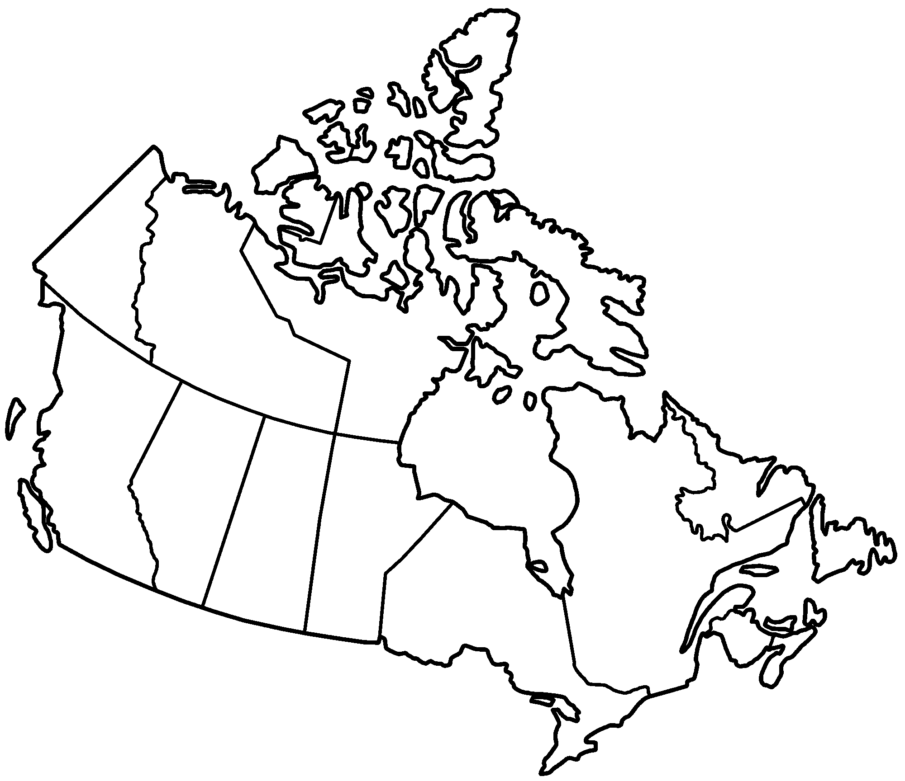
Canada’s Digital Divides Non-Urban Internet Penetration
Income
95% of Canadians in highest income quartile are connected
BUT only 62% in the lowest income quartile have Internet.
100%
27%
84% but access ranges from 17% to 90%
86%
80%
83%
78%
84%
77%
85% access in rural areas = 1,000,000 without broadband
Source: CIRA Factbook 2014 - The Canadian Internet
https://cira.ca/factbook/2014/the-canadian-internet.html
http://www.statsnwt.ca/recent_surveys/

Slide 11
Appendix
Government of Canada Advertising Activities 2015/2016

Slide 12
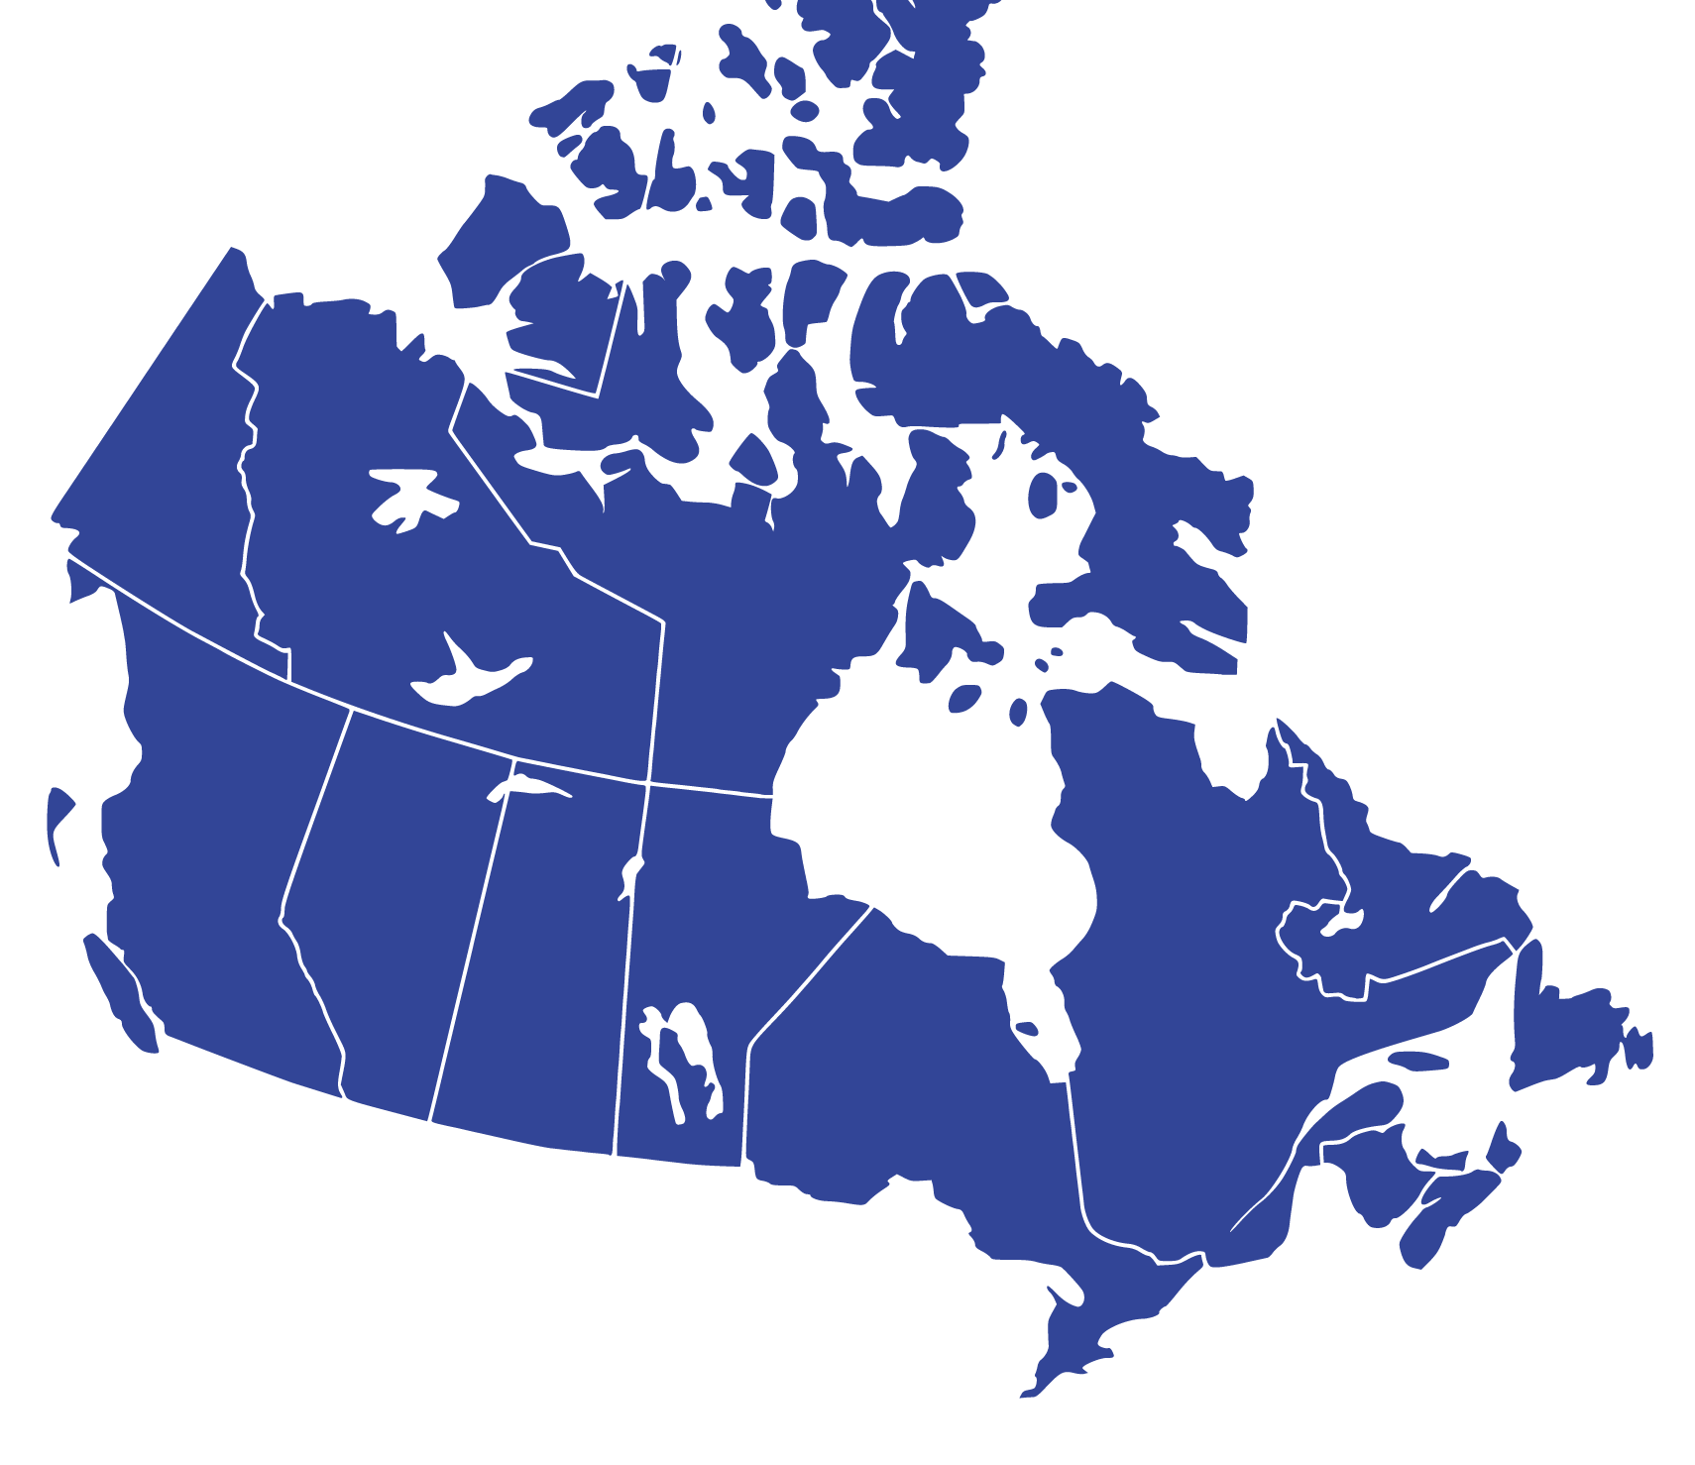
Study Details
Study Timing
December 2016
Online Panel
UThink
2,403 Canadians surveyed
National Scope
78% English / 22% French
Study Management
Totum Research
Nationally Representative Sample
Men 50%, Women 50%
18-34: 29%, 35-49: 26%, 50-64: 27%, 65+ 18%
West 31%, Ontario 39%, Quebec 23%, Atlantic 7%
Margin of Error
±2.0% at the 95% confidence level

Slide 13
Federal Government Advertising Expenditures by Type 2002-2016
% of total spending
Source: Public Works and Government Services Canada
http://www.tpsgc-pwgsc.gc.ca/pub-adv/annuel-annual-eng.html
*NOTE: Print Weeklies/Community includes spending on Official Language, Ethnic and Aboriginal publications

Slide 14
Federal Government Advertising Expenditures by Type 2002-2016
% | 2002-2003 | 2003-2004 | 2004-2005 | 2005-2006 | 2006-2007 | 2007-2008 | 2008-2009 | 2009-2010 | 2010-2011 | 2011-2012 | 2012-2013 | 2013-2014 | 2014-2015 | 2015-2016
Television | 44.58 | 49.35 | 43.70 | 26.00 | 35.56 | 35.30 | 31.41 | 39.55 | 47.85 | 36.81 | 60.10 | 46.42 | 54.27 | 50.51
Radio | 7.86 | 5.92 | 11.30 | 11.30 | 18.77 | 19.26 | 13.15 | 16.53 | 7.57 | 27.73 | 2.27 | 11.91 | 5.33 | 5.41
PRINT - NEWSPAPERS | 31.88 | 28.46 | 34.60 | 47.00 | 25.99 | 25.12 | 27.21 | 27.42 | 10.99 | 10.27 | 11.46 | 7.51 | 7.20 | 5.54
Print Weeklies / Community* | 9.98 | 14.09 | 18.00 | 19.00 | 11.82 | 10.90 | 9.33 | 16.81 | 6.65 | 8.32 | 9.75 | 3.65 | 6.48 | 3.85
Print Dailies / National News | 21.90 | 14.36 | 16.60 | 28.00 | 14.17 | 14.22 | 17.88 | 10.61 | 4.34 | 1.95 | 1.71 | 3.86 | 0.72 | 1.70
Print Magazines | 9.93 | 12.00 | 2.80 | 5.30 | 4.41 | 4.92 | 2.53 | 2.41 | 5.53 | 3.91 | 1.48 | 1.11 | 1.32 | 1.50
Out of Home | 4.90 | 2.78 | 4.30 | 4.40 | 6.47 | 6.56 | 9.84 | 4.58 | 7.71 | 6.40 | 3.05 | 4.82 | 1.93 | 0.82
Internet | 0.85 | 1.49 | 0.80 | 5.90 | 7.15 | 8.79 | 13.51 | 8.02 | 14.58 | 13.69 | 19.81 | 27.05 | 27.81 | 34.11
Cinema | 0.00 | 0.00 | 2.10 | 0.10 | 1.65 | 0.05 | 2.34 | 1.49 | 5.78 | 1.19 | 1.83 | 1.17 | 2.15 | 2.11
Source: Public Works and Government Services Canada
http://www.tpsgc-pwgsc.gc.ca/pub-adv/annuel-annual-eng.html
*NOTE: Print Weeklies/Community includes spending on Official Language, Ethnic and Aboriginal publications

Slide 15
Federal Government Advertising Expenditures – Newspapers 2015-16
Daily Newspapers
$513,120
(1.7% of Total)
Community Newspapers
$488,563
(1.6% of Total)
Official Language, Ethnic, Aboriginal Newspapers
$676,004
(2.2% of Total)
Total Newspapers $1,677,687
(5.5% of Total Media Spend of $30,269,041)

