Slide 1
Ten Tweetable Truths
February 2021

Slide 2
Almost nine in ten Canadians read a newspaper every week.
1
Access to digital platforms has only increased access to news content. More Canadians than ever are reading in print or digital formats.
2020 weekly readership was 86%
ALMOST NINE OUT OF TEN
Canadians (86%) read news media brands each week in 2020.
READERSHIP
2012 weekly readership was 85%
Source: Totum Research, Canadians 18+; Weekly Readership (Community or Daily); 2020

Slide 3
Readers choose multiple platforms to read newspaper content.
2
82% of print readers also read in digital.
70% of digital readers also read in print.
Source: Totum Research, Canadians 18+; 2020

Slide 4
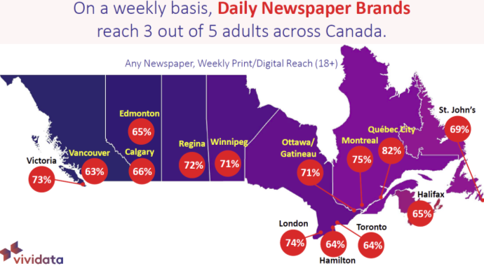
Daily newspapers reach 3 in 5 adults across Canada weekly.
3
The highest newspaper reach is in Quebec City (82%), Montreal (75%), and London (74%).
Source: Vividata Fall 2020 Study

Slide 5
Young Adults read newspapers differently than older adults.
4
Eight out of ten Millennials (79%) use their phone to read news and keep up with current events.
And almost half of them also read printed newspapers.
Source: Totum Research, Canadians 18+, Engaged and Connected; 2019

Slide 6
Eight in ten (82%) Canadians feel that reliable journalism is an essential part of a democratic society and are concerned about the repercussions of fake news and it being used as a weapon.
Reliable journalism is essential.
5
Source: Totum Research, Canadians 18+; 2020

Slide 7
Local information is the main reason for reading community newspapers.
6
Nine in ten (89%) print readers read for local information.
Advertising is a key readership driver for printed newspaper readers.
Half (50%) are reading for ROP/Flyers; and
42% read for classifieds, jobs, and real estate information.
Source: Totum Research, Canadians 18+; Readers of Community Newspapers in Print/Digital; 2020
*Local information = local news, editorial, sports, entertainment, events, crime features, obituaries
Notes:
We continue to explore the reasons for reading community newspapers and one thing never changes. Local information (in many forms) continues to be the driving reason for readership of community newspapers. This study asked about both print and digital formats for the following list of different types of local information:
Local news
Local editorial
Local sports
Local entertainment
Local events
Local crime features
Obituaries
After local information about half are reading for the advertising – this includes ROP ads throughout the paper as well as Flyers/Inserts. Considerably more print readers choose advertising and that is likely attributed to Flyers and Inserts.
And finally, we are still seeing readership of classified ads as well as employment/careers and real estate in printed community newspapers.

Slide 8
Almost half of print community newspaper readers read for flyers.
7
Eight in ten (77%) community newspaper readers use flyers to plan grocery purchases.
Flyers are also used for entertainment/restaurants (56%), health/personal care (53%), and clothing (51%) purchases.
Source: Totum Research, Canadians 18+, Engaged and Connected; 2019
Vividata Fall 2020 Study

Slide 9
News media ads inspire action.
8
After being exposed to a news media ad, 57% of Canadians went online for more information about a product/service and more than half (54%) visited a store.
63%
57%
37%
54%
50%
32%
Source: Totum Research, Canadians 18+, Engaged and Connected; 2019
Notes:
News media ads (in print or digital formats) generate awareness among almost two thirds of readers (63%).
- Three quarters of awareness is generated from print ads (34 print + 15 both = 49% out of 63% total = 77% of awareness generated by printed newspaper ads.

Slide 10
When reading a newspaper, Canadians give it full attention.
9
Media Engagement
Printed newspapers score 102% above average for engagement, the highest of all media measured.
Engagement may be fractured with other media (television, radio, magazines, search engine).
Social media scored 15% below average in engagement.
Source: Totum Research, Canadians 18+, Engaged and Connected; 2019
Respondents were asked to rate media measured on 16 different engagement characteristics (7 General Engagement, 5 News Engagement, 4 Advertising Engagement). Results were indexed based on ratings for each media compared to the average rating.
Notes:
Engaged and Connected 2019
https://nmc-mic.ca/ad-resources/local-newspapers-engaged-and-connected/
Ten different media (traditional and digital) were measured.
Respondents were asked to rate media measured on 16 different engagement characteristics (7 General Engagement, 5 News Engagement, 4 Advertising Engagement).
Results were indexed based on ratings for each media compared to the average rating.
General Engagement:
It is trustworthy.
I feel a personal connection with the medium.
It inspires me.
It makes my life better.
It enhances my interaction with others.
It operates in an ethical manner and has the public’s best interest in mind.
I go to the medium when I have time to myself.
News Engagement:
The news it contains comes from reliable sources.
It employs well-trained and knowledgeable journalists.
It provides the news impartially.
Its news content is believable.
It contains informed commentary.
Ad Engagement:
I usually notice ads in this medium.
The ads it contains make me more likely to purchase.
It is the best place to get useful information about sales, store hours and special offers.
It contains annoying ads (Note: Less annoying earner higher engagement scores)

Slide 11
Newspapers are an essential service.
10
The COVID-19 pandemic has made it clear to Canadians that they rely on news media.
A third started reading newspapers in print or digital, and more than four in ten plan to continue reading newspapers to the same degree post-pandemic.
Source: Totum Research, Canadians 18+; 2020

Slide 12
Ten Tweetable Truths
For more information go to www.newsmediacanada.ca

